Slide 1
Symptoms and Alerts

Slide 2
Importance
Alerts notify operators when object state change, health problems, and performance degradation occur in the environment. Alerts are generated when a metric violates a defined threshold, signaling potential problems or issues on single hosts or across the entire fleet.
VCF Operations provides a comprehensive set of predefined alert definitions. You can also create custom alert definitions and symptom definitions to address specific monitoring needs.
Administrators must understand the underlying work mechanism of alert definitions and how to take actions on alerts.

Slide 3
Module Lessons
Alerts Introduction
Creating Alert Definition Components
Creating Custom Alert Definitions
Managing Alerts

Slide 4
Alerts Introduction

Slide 5
Learner Objectives
Describe the purpose of using alerts
Identify the components of an alert definition

Slide 6
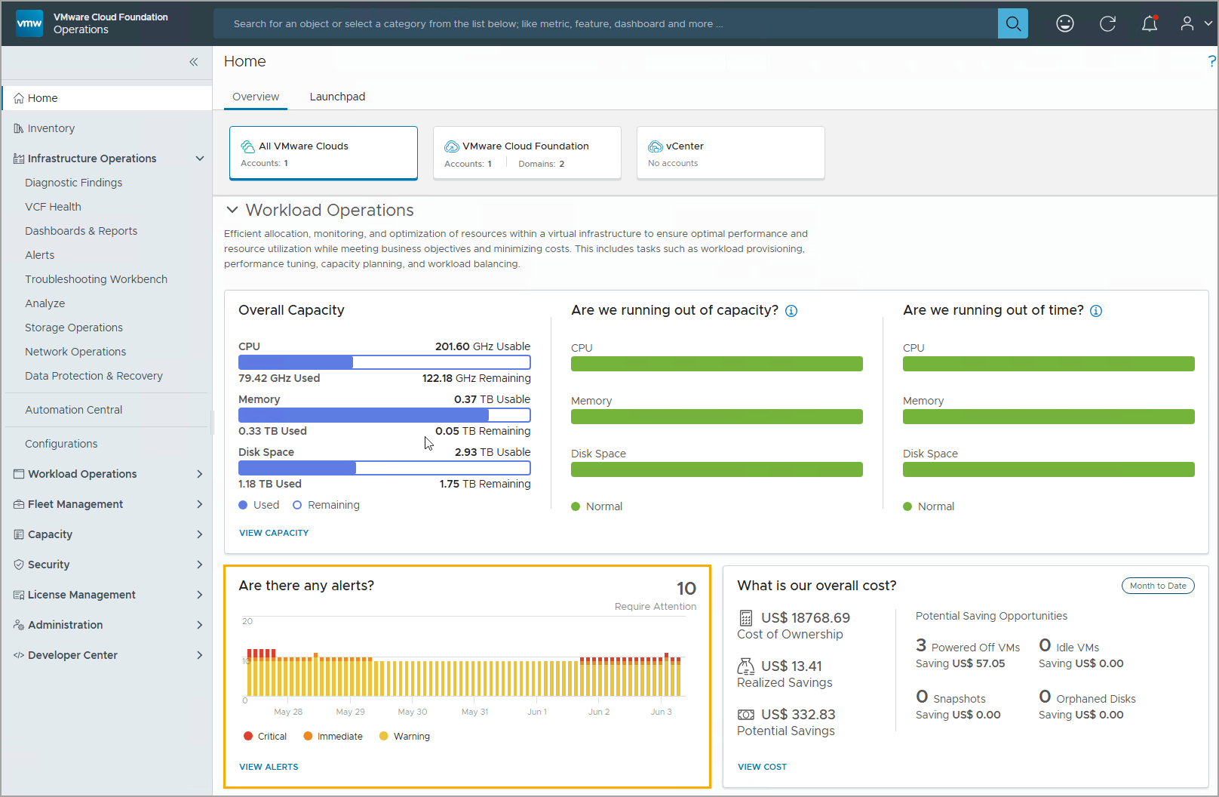
Understanding Alerts
Alerts help you identify performance, capacity, and usage problems, and provide a root-cause analysis across single objects and the fleet.
The Alerts function provides the following benefits:
Provides notifications for abnormal behaviors to help avoid incidents
Focuses on the cure (remediation)
Provides the starting point of a workflow for identifying problems
Notes:
TalkTrack:
Alerts are a crucial component for effective monitoring. They are designed to assist in identifying performance, capacity, and resource issues, providing administrators with actionable insights that pinpoint problem areas. The alert function offers significant benefits to operational efficiency. It provides continuous monitoring for anomalies within the system, ensuring that deviations from expected behavior are quickly brought to attention. Furthermore, alerts provide a unified view across the entire infrastructure. This comprehensive perspective helps in understanding system-wide health. Ultimately, alerts streamline the troubleshooting process. By highlighting specific issues, they reduce the time and effort required to identify and resolve problems. In a VCF Operations environment, alerts actively notify users when objects encounter problems. This proactive notification is invaluable in helping to focus efforts on the root cause of an issue. Beyond basic alerting, extended alerts support a deeper investigation of virtualized infrastructure issues. These include alerts from vSphere Operations and Infrastructure Operations. Additionally, the environment can be configured to send alerts to external applications using a REST API or webhooks, allowing for integration with existing workflows. When investigating an alert, there are several perspectives to consider. The "Summary" tab provides a high-level overview. The "Timeline" offers a chronological view of events leading up to the alert. The "Alerts" section provides details on the specific alert triggered. "Metrics" allows for a deeper dive into the raw performance data. "Properties" gives attribute information about the affected object. "Custom dashboards" can be linked to alerts, providing specialized views for investigation. Finally, "Auto-notifications" allow for automated responses to alerts. When an alert is triggered, it indicates a violation against a predefined configuration. The system processes the alarm based on the specified effect. For any component or object in the environment, the effect applies to objects that meet the specified criteria. For an alarm to trigger, both the trigger and impact conditions must be met. Suggested resolutions are also provided, offering guidance on how to approach and address the problem.
<End>
Alerts in VCF Operations notify you when objects in the environment have a problem. Alerts help you save time, helping you focus your efforts on the root cause of a problem. Generated alerts appear in areas of VCF Operations, such as Home > Overview and Infrastructure Operations > Alerts, so that you can monitor and respond to problems in the environment. You can also configure VCF Operations to send alerts to external applications by using one or more outbound alert options.
You can monitor alerts for a selected object (for example, virtual machine) in the following locations:
Alert Details, including the Summary, Timeline, and Metric Charts tabs
Summary tab
Alerts tab
Events tab
Custom dashboards
Alerts notifications
Based on the alert configuration, the alert is generated when one or more symptoms are triggered. The system generates an alert when the collected data for an object is compared to the alert definitions for that object type and the defined symptoms are true. As the alerts are generated, you must process the alerts based on the negative effect that they might have on the objects in your environment. Alerts indicate a problem that must be resolved so that the trigger conditions do not exist, and the alert is canceled. Suggested resolutions are provided as recommendations so that you can approach the problem with solutions.

Slide 7
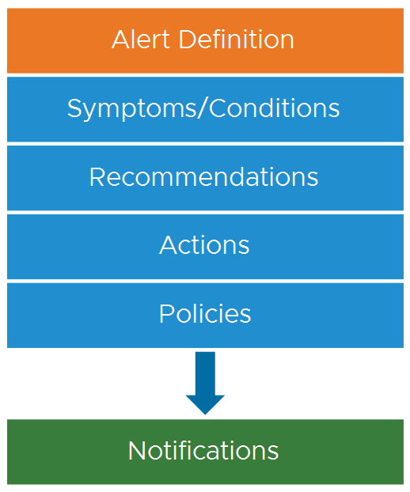
Alert Definitions and Alert Components
Alert definitions are a combination of elements that identify problem areas and generate alerts in VCF Operations.
An alert definition has the following components:
One or more Symptoms that trigger the alert
Zero or more Recommendations that might resolve the alert
Zero or more Actions
Policies that are enabled for an alert
A notification sends an alert to external applications through a plug-in such as the standard email plug-in.
Notes:
TalkTrack:
Alert definitions are carefully constructed combinations of elements that collectively identify problematic areas and subsequently generate alerts within VCF Operations. They are the backbone of the monitoring system. Each alert definition is comprised of several key components. Firstly, there are symptoms. These are the conditions or events that actually trigger the alert. An alert definition will include one or more such symptoms. Next, recommendations are an integral part. These are the suggested steps or actions that can be taken to resolve the alert. An alert definition may include zero or more recommendations, depending on the nature of the issue. Actions are also a component. These are automated or prescribed tasks that can be performed in response to the alert. Similar to recommendations, an alert definition can have zero or more associated actions. Finally, policies are crucial. These govern how an alert behaves and what triggers it. Policies define the overarching rules for an alert. In addition to these core components, a notification system is in place. This sends an alert to external applications. This typically occurs through a plug-in, such as a standard email plug-in, ensuring that relevant parties are informed. An alert definition always includes at least one symptom. It is also associated with a set of recommendations and actions, all designed to assist in resolving the problem within the monitored environment. The creation of these alert definitions is critical, as they enable the generated alerts to accurately describe the issues, and the provided recommendations guide the user towards effective solutions.
<End>
An alert definition has one or more symptom definitions. The alert definition is associated with a set of recommendations and actions that help you resolve the problem. You create the alert definitions so that the generated alerts describe the problems in the monitored environment. You can respond to the alerts with effective solutions that are provided in the recommendations.

Slide 8
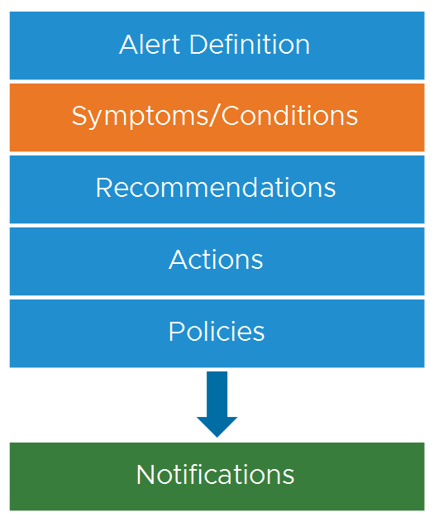
Understanding Symptoms
A symptom is a simple condition test that is performed on metrics, properties, message events, fault events, and metric events. A symptom normally indicates problems in your environment.
A symptom can apply to any object type. For example, a host, virtual machine, data store, virtual switch, or application.
The following two faulty conditions are examples of possible symptoms:
Virtual machine high-ready time on each vCPU
Host disconnected from vCenter
A symptom is the most basic building block of an alert definition. An alert definition includes a minimum of one symptom. If the condition in the symptom is met, the symptom gets triggered, which eventually triggers the alert.
Notes:
TalkTrack:
Symptoms are the foundational elements for identifying problems within an environment. A symptom is essentially a simple condition test that is performed across various data types, including metrics, properties, message events, fault events, and specific metric events. When a symptom is detected, it typically indicates a problem. A symptom can be applied to virtually any object type within the system. For instance, a symptom could monitor a host, a virtual machine, a datastore, a virtual switch, or even an application. This broad applicability ensures comprehensive monitoring. Consider two common examples of conditions that could trigger symptoms. One is a virtual machine consistently showing a high ready time on each virtual CPU. This indicates a potential performance bottleneck. Another example is a host being disconnected from vCenter, which points to a connectivity or availability issue. A symptom is the most basic building block of any alert definition. It is a mandatory component, with every alert definition requiring a minimum of one symptom. When the conditions defined within a symptom are met, the symptom itself is triggered. This triggering of the symptom is the initial step that eventually leads to the generation of an alert. Symptoms are essentially the indicators of problems. They are defined and added to alert definitions to ensure that a problem is recognized when it occurs within monitored objects. The system continuously collects data from these monitored objects. If this collected data matches the conditions specified in a symptom, then that symptom is considered triggered.
<End>
Symptoms are conditions that indicate problems in your environment. You define symptoms that you add to alert definitions so that you know when a problem occurs with your monitored objects. As data is collected from your monitored objects, the data is compared to the defined symptom condition. If the condition is true, then the symptom is triggered.

Slide 9
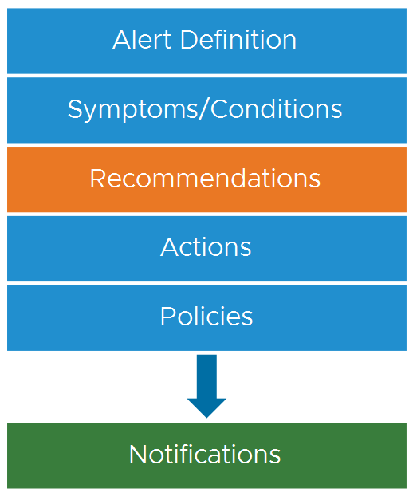
Understanding Recommendations
A recommendation is a probable solution for resolving the problem that triggered the alert.
A recommendation can include the following information:
Best practices
Vendor recommendations
Links to troubleshooting resources
You can use the built-in recommendations in VCF Operations or create your custom recommendations.
Notes:
TalkTrack:
Recommendations are a core component of alert definitions. A recommendation offers a probable solution to the problem that initially triggered the alert. They are designed to guide users towards resolving issues. A recommendation can contain various types of helpful information. This includes best practices, which provide general guidance for addressing common issues. Vendor recommendations are also often included. These are specific solutions or advice provided by the hardware or software vendor. Additionally, recommendations can provide direct links to troubleshooting resources. These links can point to documentation, knowledge base articles, or other helpful materials. The system allows for the use of built-in recommendations provided by VCF Operations. However, there is also the flexibility to create custom recommendations, tailored to unique environmental needs or operational procedures. An alert can have zero or more recommendations associated with it. The text of a recommendation clearly outlines the necessary steps to resolve the triggered alert. Without these recommendations, an administrator or operator would lack clear guidance on how to address a problem. For example, a recommendation might list a series of steps that an administrator or operator should perform to resolve the issue. It could also provide specific instructions, such as notifying a virtual infrastructure administrator when a problem occurs. This customization allows for the creation of specific recommendations, which can then be added to an alert definition, ensuring that if a suitable recommendation does not already exist, it can be created and applied.
<End>
An alert can have zero or more recommendations. The recommendation text describes what must be done to resolve the triggered alert. You can include what you want in the description of the recommendation. Without recommendations, an administrator or operator has no guidance to resolve the alert. For example, you might include a list of steps that an administrator or operator must perform to resolve the problem. You might also provide instructions to notify a virtual infrastructure administrator when a problem occurs. You create your own recommendations and add them to your alert definition if a suitable recommendation does not already exist.

Slide 10
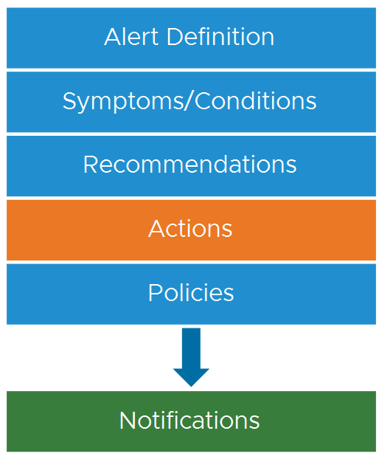
Understanding Actions
An action provides a single-click method (automated) for fixing the problem that you are trying to resolve.
Actions are associated with recommendations, and actions are optional to an alert definition. A recommendation can include one or more actions.
Actions are from the following sources:
Built in the product
Installed solutions
The possible actions include read actions and update actions.
Notes:
TalkTrack:
Actions are an optional, but very powerful, component within an alert definition. An action provides a single-click, often automated, method for resolving the problem that triggered the alert. Actions are closely linked with recommendations. A recommendation can include one or more actions, offering immediate steps to take. Actions originate from various sources. Some actions are built directly into the product. Others come from installed solutions, which are often integrated management packs or extensions. The types of actions available typically include "read actions" and "update actions." Read actions retrieve data from target objects, providing further information. Update actions, conversely, modify data or objects in the monitored systems. These update actions are commonly provided as part of a solution, often a native management pack configuration. They are accessible from the object actions menu found under the objects page. Importantly, actions can also be added to alert definition recommendations. Consider an example. An action could modify a target object. For instance, an alert definition could be configured to detect when a virtual machine experiences memory problems. In this scenario, an action could be added to the recommendations that automatically runs a "set memory" operation for that virtual machine. This action would increase the memory, directly resolving the cause of the alert.
<End>
Actions update objects or read data about objects in monitored systems and are commonly provided in VCF Operations as part of a solution. The actions are added as part of the solution (native management pack) configuration. These actions are available from the object Actions menu under the objects page. Also, actions can be added to alert definition recommendations. The read actions retrieve data from the target objects. The update action modifies the target objects. For example, you can configure an alert definition to notify when a virtual machine experiences memory problems. Add an action in the recommendations that runs the set memory for the VM action. The action increases the memory and resolves the cause of the alert.

Slide 11
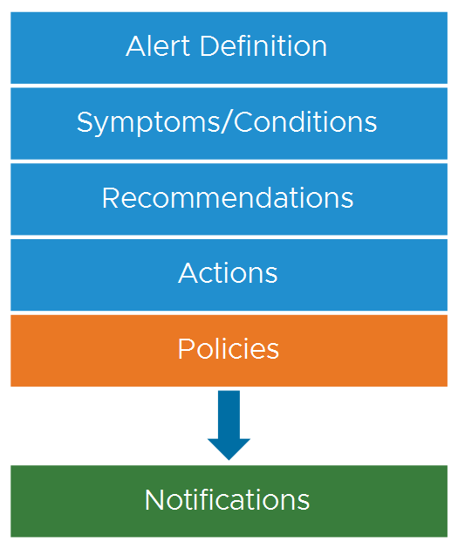
Understanding Policies
A policy in VCF Operations is a set of rules that define how information about objects are collected, displayed, and analyzed.
Each policy can inherit settings from another policy. Then you can customize and override policy settings to support the service-level agreements and business priorities established for your environment.
A policy includes the following settings:
Metrics or properties for object types such as VM, host, or data store
Symptom and alert definitions
Threshold definitions for factors such as workload, time remaining, and capacity remaining
Notes:
TalkTrack:
Policies are foundational rules within VCF Operations. They define precisely how information about objects is collected, displayed, and subsequently analyzed. Each policy has the capability to inherit settings from other policies. This allows for a hierarchical structure, promoting consistency. Furthermore, inherited policy settings can be customized and overridden. This flexibility ensures that policies align with specific service level agreements and business priorities established for the environment. A policy includes several important settings. These cover metrics or properties for various object types, such as virtual machines, hosts, or datastores. This ensures that the relevant data is always being monitored. Policies also encompass symptom and alert definitions. These linkages ensure that the rules governing data collection directly inform how problems are identified and alerted upon. Finally, policies include threshold definitions. These are critical for various factors, such as workload, time remaining, and capacity remaining. These thresholds trigger alerts when defined limits are approached or exceeded, providing proactive notification of potential issues.
<End>

Slide 12
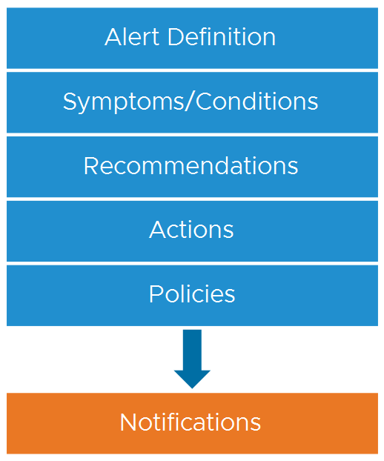
Understanding Notifications
When alerts are generated in VCF Operations, the alerts appear in various places in the VCF Operations console such as the Alerts page and the object’s Summary tab.
You can configure VCF Operations to send triggered alerts to an external alert notification system with a notification.
You connect VCF Operations to the external alert notification system by configuring an outbound alert plug-in. For example, you can send alerts by using email.
Notes:
TalkTrack:
Notifications are the final step in the alert process. When alerts are generated in VCF Operations, they are visible in several locations, including the Alerts page and the object's Summary tab within the VCF Operations console. Beyond internal visibility, VCF Operations can be configured to send triggered alerts to external alert notification systems. This is accomplished by setting up a notification with a plug-in. To connect VCF Operations to an external alert notification system, an outbound alert plug-in needs to be configured. For instance, emails can be used to send these alerts, integrating with existing communication channels. This ensures that critical alerts reach the appropriate personnel or systems, even outside the direct VCF Operations interface.
<End>

Slide 13
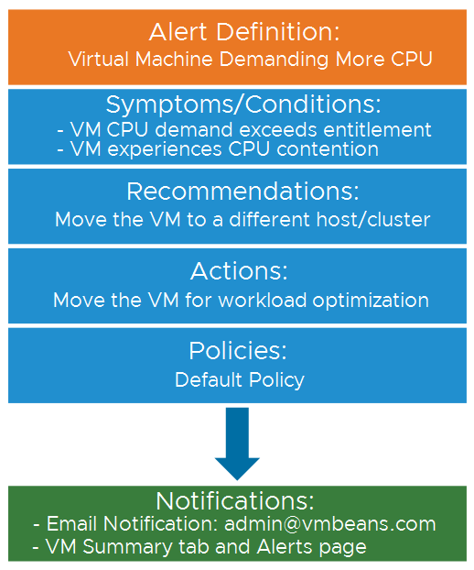
Alert Definition Example
An alert definition provides useful information for resolving problems.
The following example provides details about an alert definition:
Name: Virtual machine in a DRS cluster demands more CPU than its entitlement.
Description: Virtual machine in a DRS cluster demands more CPU than its entitlement.
Symptoms:
The virtual machine's CPU demand exceeds its entitlement.
The virtual machine experiences CPU contention.
Recommendations: Move the virtual machine to a different host or cluster.
Actions: Move the VM for workload optimization.
Notes:
TalkTrack:
This example demonstrates a practical application of an alert definition. The specific problem identified is a virtual machine in a DRS (Distributed Resource Scheduler) cluster demanding more CPU than its allocated entitlement. The description reiterates the problem: a virtual machine in a DRS cluster is demanding more CPU than it is entitled to. This provides immediate clarity on the issue. The symptoms section details the conditions that trigger this alert. Firstly, the virtual machine's CPU demand is exceeding its entitlement. Secondly, the virtual machine is experiencing CPU contention, indicating a resource bottleneck. To resolve this issue, the recommendation is to move the virtual machine to a different host or cluster. This suggests a direct action to alleviate the CPU over-demand and contention. The action associated with this recommendation is to move the virtual machine for workload optimization. This implies an automated or prescribed task to relocate the VM, aiming to balance the workload and resolve the performance issue. These components collectively provide a clear and actionable framework for identifying, understanding, and resolving the specified CPU resource problem within the virtual environment.
<End>

Slide 14
Comparing Alerts, Dashboards, and Reports
Alerts, views, dashboards, and reports can all provide data and insights. You must be able to differentiate their distinctive nature and primary use cases to make the best use of these functions.
 | Alerts | Views/Dashboards | Reports
Nature | Reactive | Proactive | Passive
Suitability | Exceptions | Exceptions/Big Picture/Details Analysis | Big Picture/Nonurgent Exceptions
Primary Use Cases | Initial Troubleshooting | Further Troubleshooting/Monitoring | Data Export and Sharing
Time/Urgency | Urgent/Important | Regular (daily, SOP) | Nonurgent/Optional/Reports on a set schedule
Roles | Operations Team | Operations Team/Architect | IT Management/Auditor
Notes:
TalkTrack:
Alerts, views, dashboards, and reports are all valuable tools for gaining insights into an environment. It is important to understand their distinct nature and primary use cases to make the best use of each function. In terms of their nature, alerts are reactive. They respond to specific conditions or events that have already occurred. Views and dashboards are proactive. They provide continuous monitoring and visualization of data. Reports are passive. They present historical data at scheduled intervals or on demand. Regarding suitability, alerts are best for identifying exceptions or anomalies. Views and dashboards are well-suited for a broader picture and detailed analysis, as well as for real-time monitoring. Reports are designed for understanding big-picture trends and non-urgent exceptions. The primary use case for alerts is initial troubleshooting. For views and dashboards, the main use is further troubleshooting and continuous monitoring. Reports are primarily used for data export and sharing. In terms of time and urgency, alerts are typically urgent or important, requiring immediate attention. Views and dashboards are for regular use, often daily or as part of standard operating procedures. Reports are non-urgent or optional, generated on a set schedule. Finally, regarding roles, alerts are typically managed by the operations team. Views and dashboards are used by both the operations team and architects. Reports are often utilized by IT management or auditors. To summarize the scope, alerts are focused on availability, performance, compliance, configuration, and capacity, specifically in emergency scenarios. Views and dashboards cover availability, performance, capacity, compliance, configuration, and inventory. Reports are similar in scope to views and dashboards but lack interactivity and real-time performance data, and are time-bound.
<End>
Scope Comparison:
Alerts: Availability, Performance, Compliance, Configuration, Capacity (emergency scenarios only)
Views/Dashboards: Availability, Performance, Capacity, Compliance, Configuration, Inventory
Reports: similar to the scope of views/dashboards, but no interactivity, no performance report, and have a time bound

Slide 15
Review of Learner Objectives
Describe the purpose of using alerts
Identify the components of an alert definition

Slide 16
Creating Alert Definition Components

Slide 17
Learner Objectives
Create static symptom definitions
Configure different threshold types for symptoms
Configure recommendations and actions for an alert

Slide 18
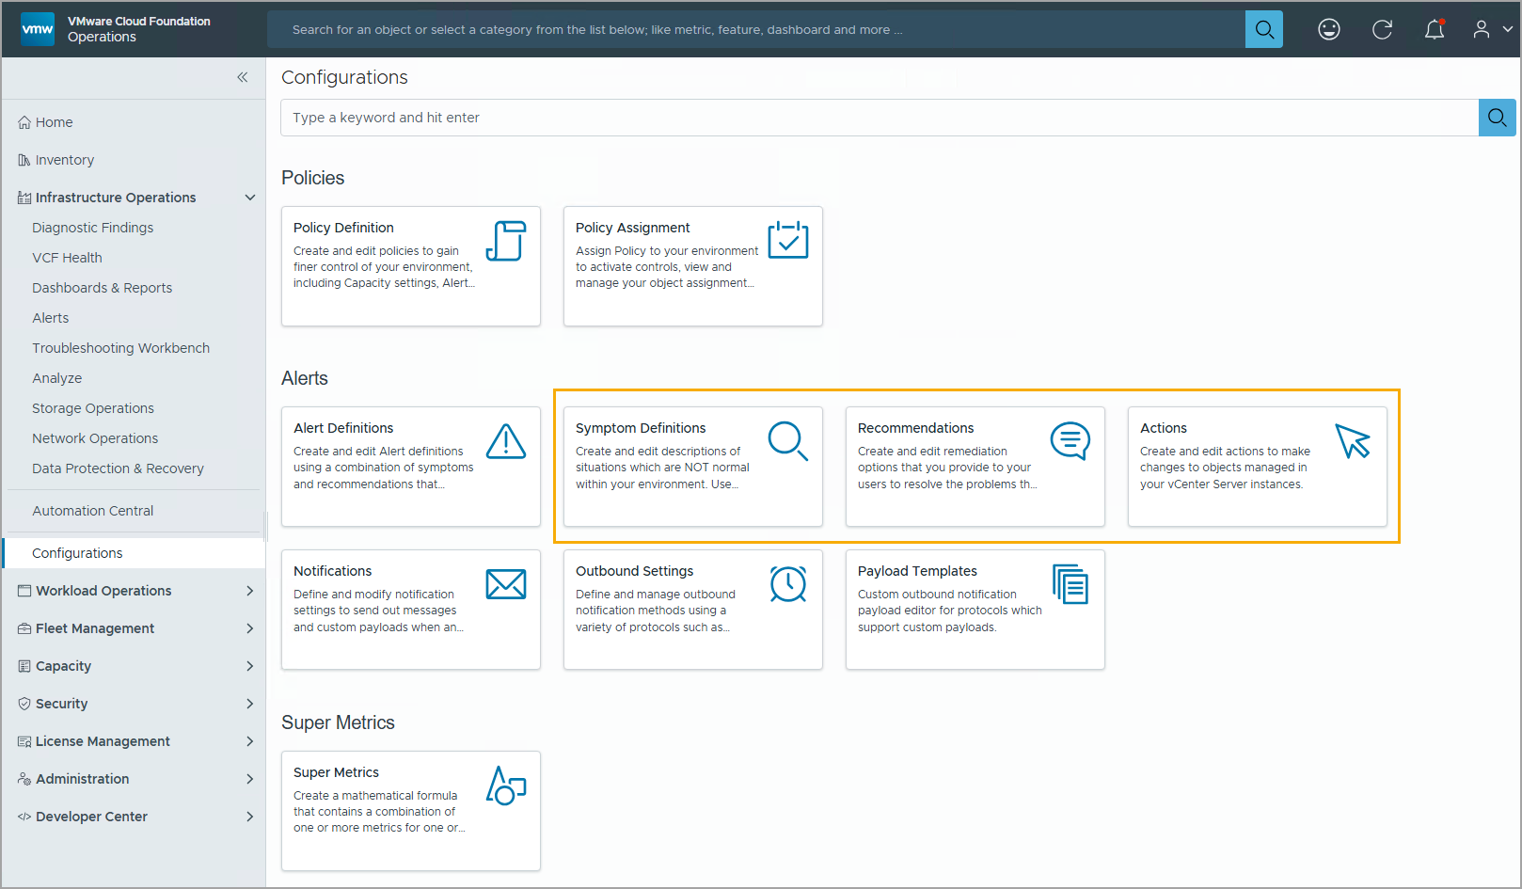
Viewing Alert Components in VCF Operations
To view the three core alert components, Symptom Definitions, Recommendations, and Actions, navigate to Infrastructure Operations > Configurations.
Notes:
TalkTrack:
Alert components are managed within the VCF Operations interface. To access these core components, including Symptom Definitions, Recommendations, and Actions, navigate to Infrastructure Operations, and then Configurations. This central location provides access to all aspects of alert configuration.
<End>

Slide 19
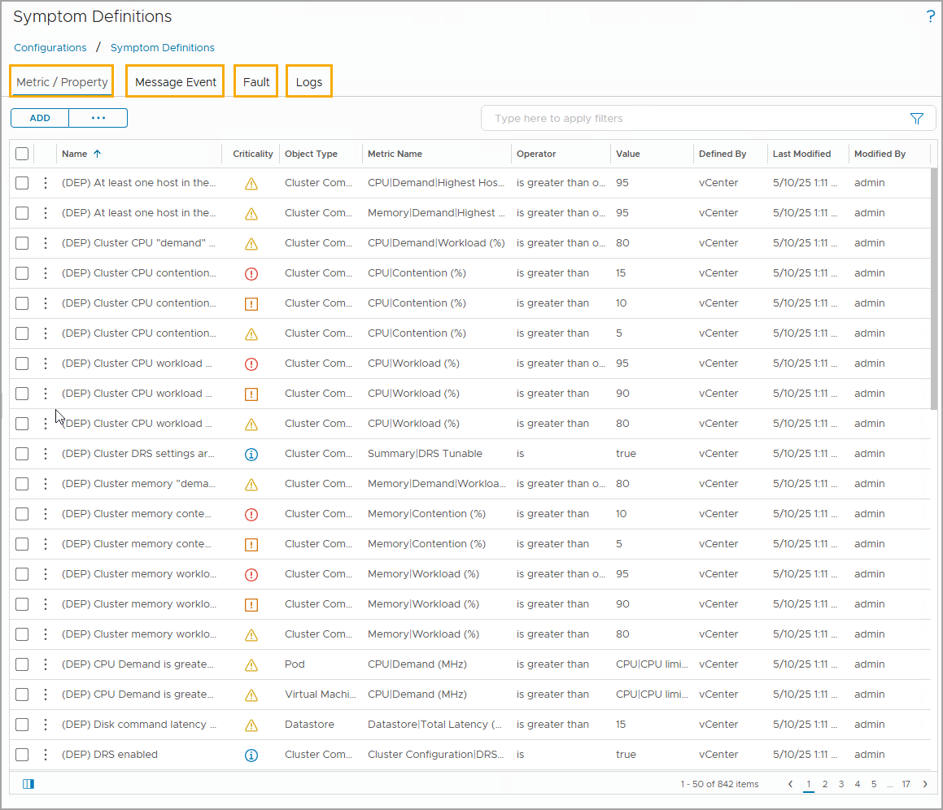
Viewing Symptom Definitions
When creating an alert definition, you must associate one or more symptom definitions.
You can use the built-in symptom definitions or create custom ones. To view all symptom definitions in your VCF Operations console, navigate to Infrastructure Operations > Configurations > Symptom Definitions. The following types of symptom definitions are available:
Metric / Property
Message Event
Fault
Logs
Notes:
TalkTrack:
When creating an alert definition, it is essential to associate one or more symptom definitions. These symptoms are the conditions that trigger the alert. VCF Operations provides flexibility in creating symptom definitions. Users can utilize built-in symptom definitions, or they can create custom ones tailored to specific needs. To view all symptom definitions within the VCF Operations console, navigate to Infrastructure Operations, then Configurations, and finally Symptom Definitions. This pathway leads to a comprehensive list of all defined symptoms. There are four primary types of symptom definitions. The first type is based on metrics or properties. These symptoms evaluate numerical data or attribute values of objects. The second type is based on message events. These symptoms are triggered by specific system messages. The third type involves faults. These symptoms react to error conditions or failures within the environment. Finally, symptoms can be based on logs. These symptoms analyze log data for specific patterns or entries, providing another layer of detection for anomalies.
<End>

Slide 20
Understanding Symptom Definition Types
Symptom definitions are categorized into the following types:
Metric/Property:
Metric symptoms are based on the operational or performance values collected from the target objects in your environment.
Property symptoms are based on the configuration properties collected from the target objects.
Message Event: Symptoms are based on the events received as messages from a component of VCF Operations or from an external monitored system through the monitored system’s REST API.
Fault: Symptoms are based on events in the monitored systems that affect the availability of objects in your environment.
Logs: Symptoms are based on log data coming from VCF Operations for logs in the monitored systems that affect the availability of objects in your environment.
Notes:
TalkTrack:
Symptom definitions are categorized into four distinct types. Understanding these types is crucial for effectively configuring alerts. The first type is based on metrics or properties. Metric symptoms are triggered by operational or performance values collected from the target objects in the environment. Property symptoms, on the other hand, are based on configuration properties gathered from those same target objects. The second type is based on message events. These symptoms are triggered by messages received from a component of VCF Operations or from an external monitored system, often through the monitored system's REST API. The third type is based on faults. Fault symptoms are triggered by events in the monitored systems that directly impact the availability of objects in the environment. These are critical for detecting outages or severe issues. The fourth type is based on logs. Log symptoms are triggered by analyzing log data coming from VCF Operations for Logs, specifically looking for patterns or keywords in the monitored systems that indicate a problem affecting object availability. To illustrate, consider some examples of each type. A metric symptom might trigger if a virtual machine's CPU Ready percentage exceeds 10 percent. A property symptom could be triggered if a host becomes disconnected from vCenter. A message event symptom might fire if a license is set to expire in less than 10 days. A fault symptom would indicate if a host loses connectivity to its storage device. Lastly, a metric event symptom, which differs from a simple metric symptom, is based on conditions reported by selected metrics from an external monitored system and is typically tied to hard thresholds within VCF Operations.
<End>
Examples of each type of symptom definitions:
Metric symptoms: For example, virtual machine metric shows CPU Ready% > 10.
Property symptoms: For example, a host disconnected from vCenter.
Message event symptoms: For example, license expires in less than 10 days.
Fault symptoms: For example, a host has lost connectivity to its storage device.
Metric event symptoms are based on the conditions reported for the selected metrics by an external monitored system. Metric event symptoms are different from the metric symptom, which are based on thresholds that VCF Operations actively monitors. For example: metric event is above the hard threshold.

Slide 21
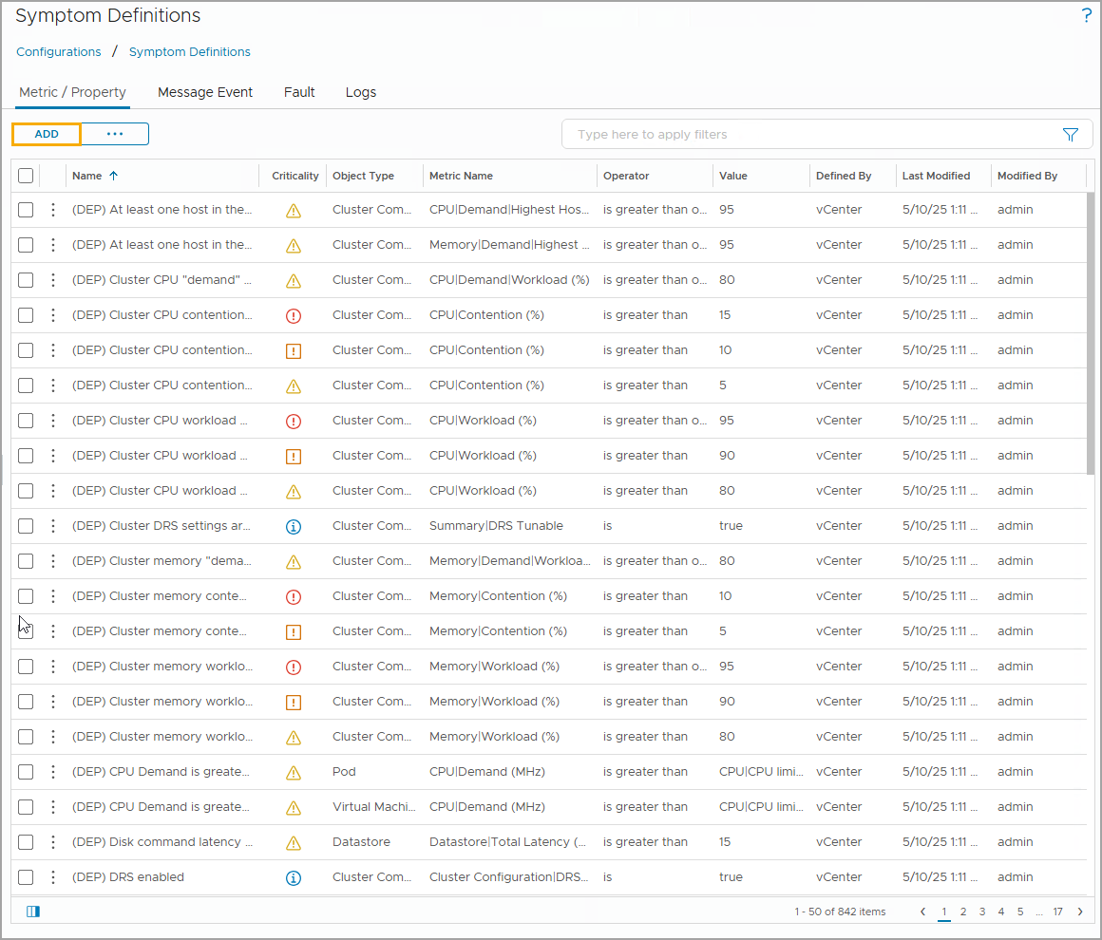
Creating Symptom Definitions
To add a new custom symptom definition, click the symptom definition type to verify that you are on the correct symptom definition type tab and click ADD.
When you create a symptom definition:
Select the base object type.
Select the symptom type.
Configure the symptom definition.
Notes:
TalkTrack:
Creating a new custom symptom definition involves a specific process. First, ensure the correct symptom definition type tab is selected. After confirming the tab, click the "Add" button to begin defining the new symptom. When defining a symptom, there are three main steps. The first step is to select the base object type. This specifies which type of object the symptom will monitor, such as a virtual machine, host, or datastore. The second step involves selecting the symptom type. As previously discussed, this could be a metric or property, message event, fault, or log-based symptom. Choosing the correct type ensures the symptom evaluates the relevant data. The final step is to configure the symptom definition. This involves setting the specific conditions and thresholds that will trigger the symptom. For example, for a metric-based symptom, this would include defining the metric to monitor, the operator (e.g., greater than, less than), and the value that constitutes the threshold.
<End>

Slide 22
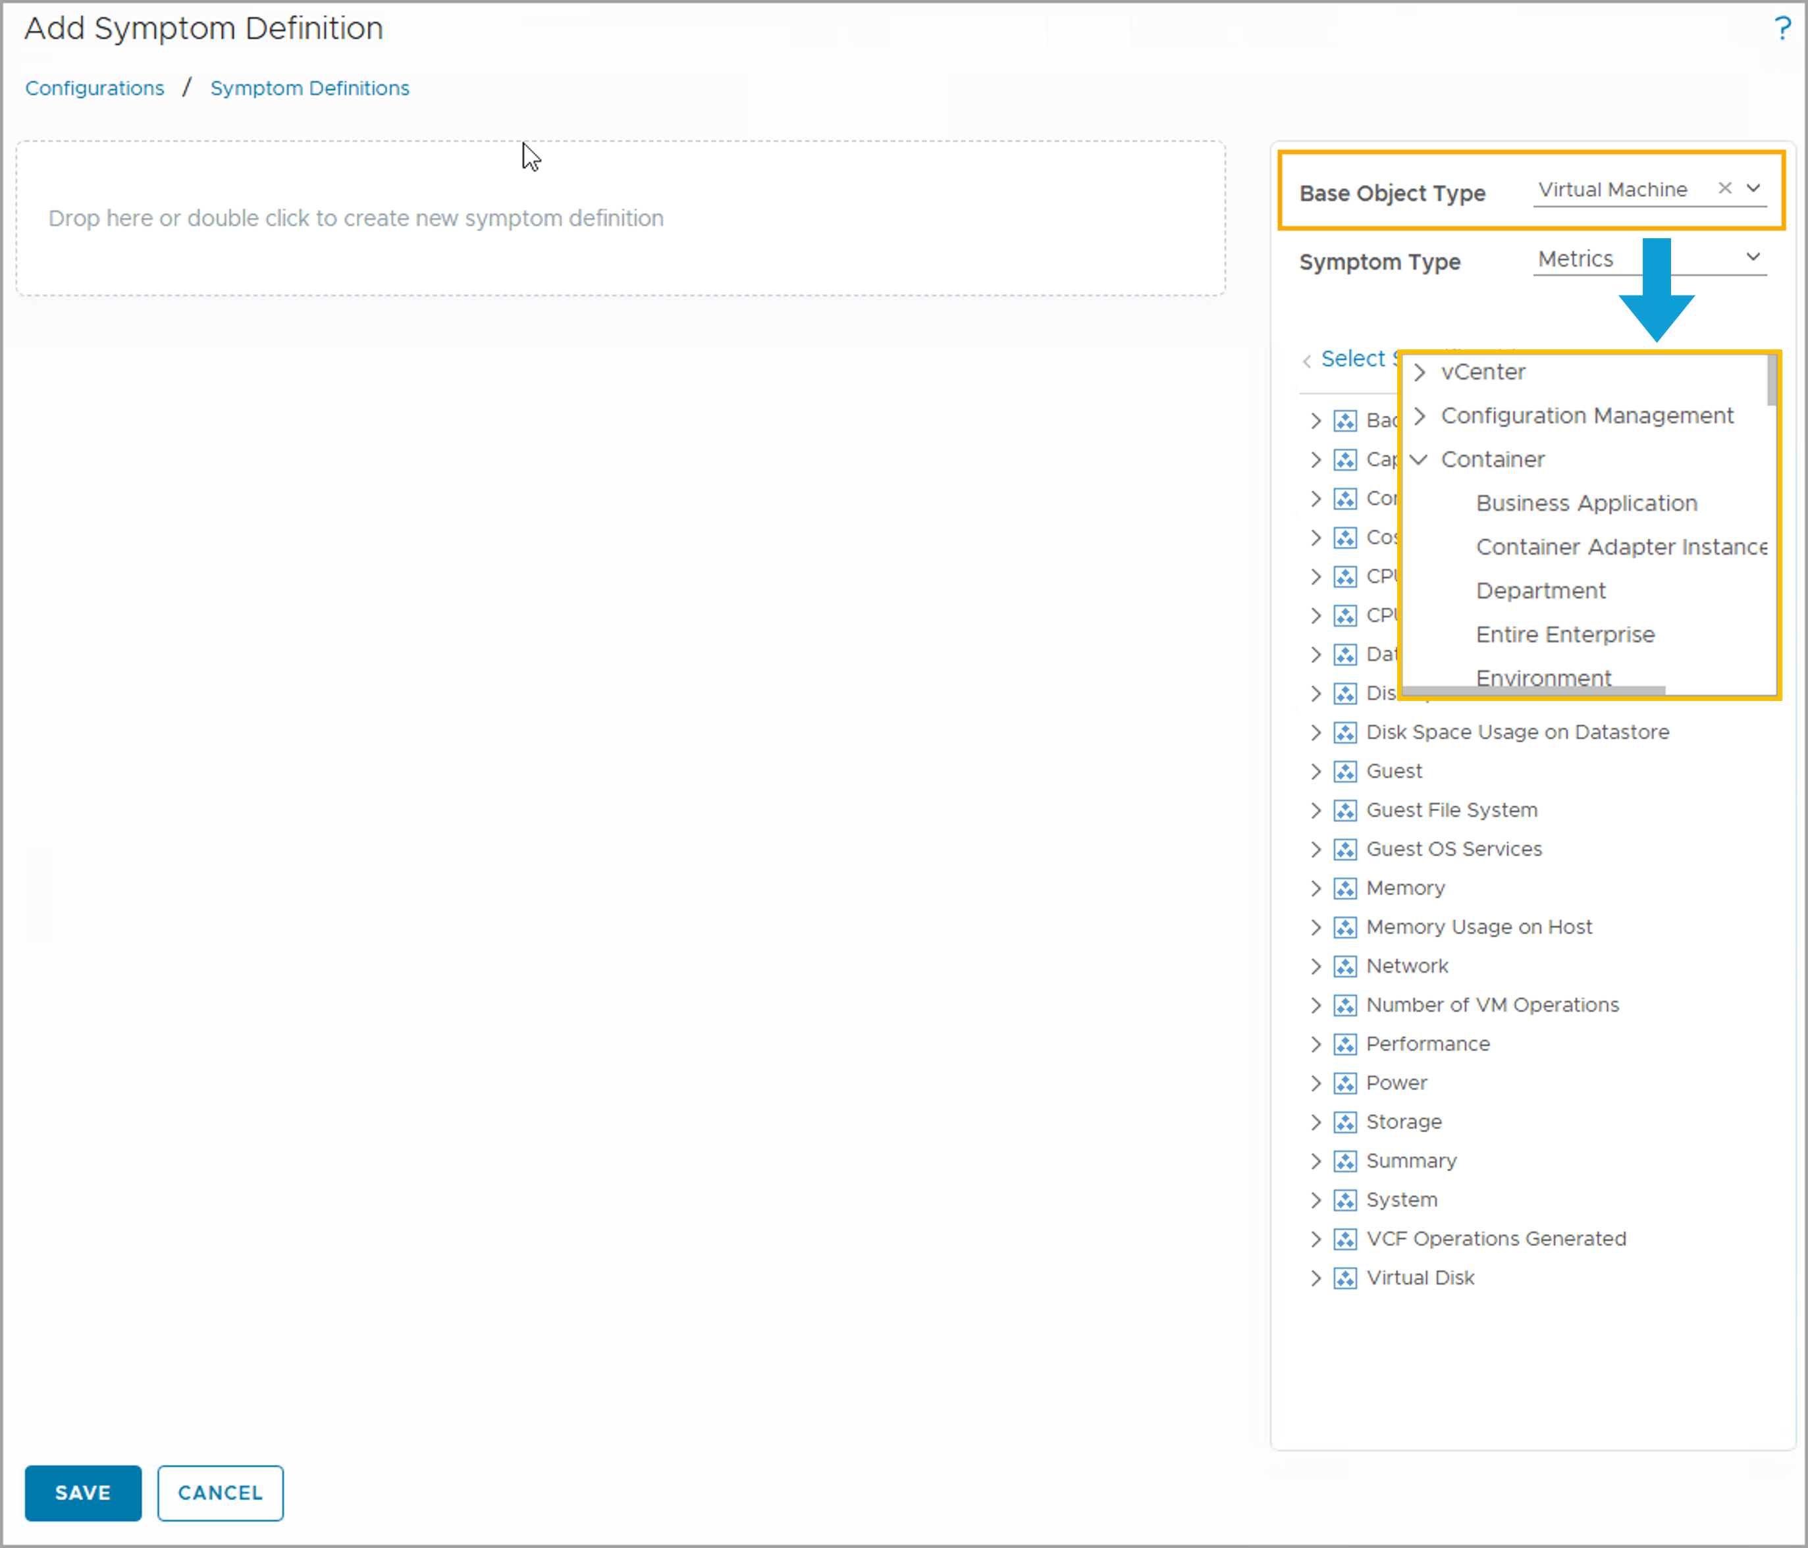
Selecting the Base Object Types
The base object type is the object type against which the symptom is evaluated.
When you add a symptom definition, you select the object for which the symptom is evaluated. A base object type can represent single objects, such as virtual machines, or represent a broader scope, such as clusters. In this case, the objects being evaluated are virtual machines.
Adapters and containers organize and display the object types. You can also search for an object type.
Notes:
TalkTrack:
When selecting the base object type for a symptom definition, it is crucial to specify the object type against which the symptom will be evaluated. When adding a symptom definition, selecting the object for which the symptom is evaluated is key. A base object type can represent high-level objects, such as virtual machines, or it can represent a broader scope, such as clusters. In the case of clusters, the objects being evaluated are virtual machines contained within those clusters. Navigators and containers organize and display the object types. There is also an option to search for an object type directly. Object types are further organized by containers and collectors, or by specialized groups. These special groups can represent custom object groups that have been created. Users can utilize the search box to find a part of, or the complete, object type name. It is important to note that the symptom type field may not be immediately interactive. Its behavior depends on the chosen symptom definition. If a new symptom definition is added from the Metric/Property tab, the symptom type can be configured by choosing between Metric or Property. However, if a new symptom definition is added from the Message Event or Fault tabs, it is not possible to further configure the symptom type fields, as these are inherently defined by the nature of the event itself.
<End>
Object types are organized by containers and adapters. Containers are special groups, environment for example, or custom object groups that you create. You can use the search box if you search for an object type. You can enter a part or the complete object type name in the search box.
Note: The Symptom Type field may not be interactable as it is dependent on where you add the symptom definition. If you add a new symptom definition from the Metric/Property tab, you can configure the Symptom Type setting by choosing between Metric or Property. If you add the new symptom definition from the Message Event or Fault tab, you won't be able to further configure the Symptom Type field.

Slide 23
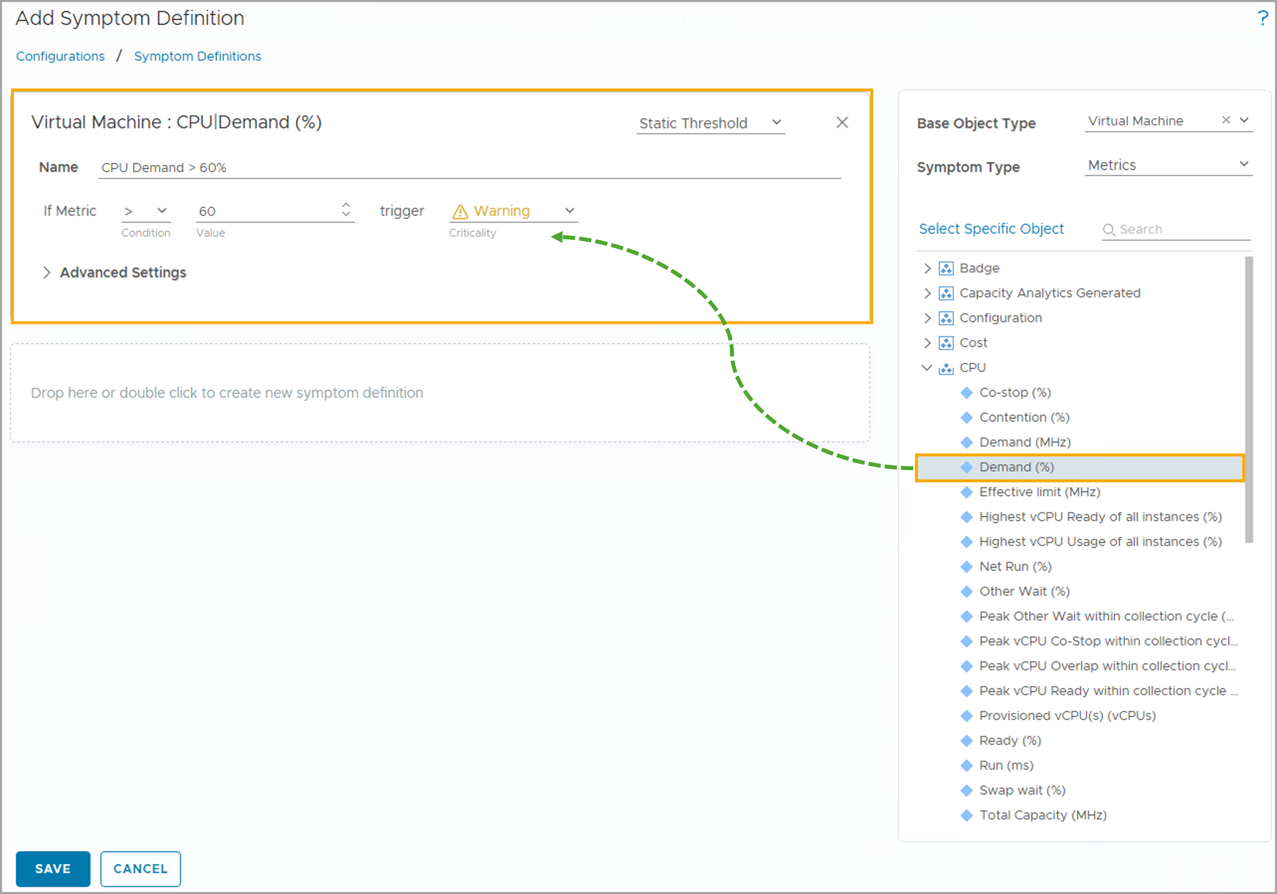
Selecting Metrics
After selecting the base object type, you can drag metrics from the expanded metric list to the new symptom definition area.
Notes:
TalkTrack:
After a base object type has been selected, the next step is to choose the specific metrics for the new symptom definition. This is done by dragging metrics from the expanded metric list directly into the new symptom definition area. By default, the list of common metrics appears. These are metrics that are frequently relevant across various objects. Additionally, any related objects for the selected base object type will share common metrics, making it easier to find relevant data points. If a specific metric or super metric is not immediately visible, it might be found in a different common or collecting metric list. This depends on the selected base object type. The "Select Object" icon can be used to inspect the metrics of a selected object. By choosing a specific object, the user can locate the precise property needed to create the symptom. This ensures that even less common or highly specific metrics can be incorporated into symptom definitions for precise monitoring.
<End>
In the example, the Demand (%) CPU metric is selected. By default, the list of common metrics appears. Related objects for the selected base object type share common metrics. A metric or super metric might not appear in the common metric or collecting metric list, based on the selected base object type. You can use the Select object icon to inspect the metrics of a selected object. By selecting a specific object, you can find the property that you must use to create the symptom.

Slide 24
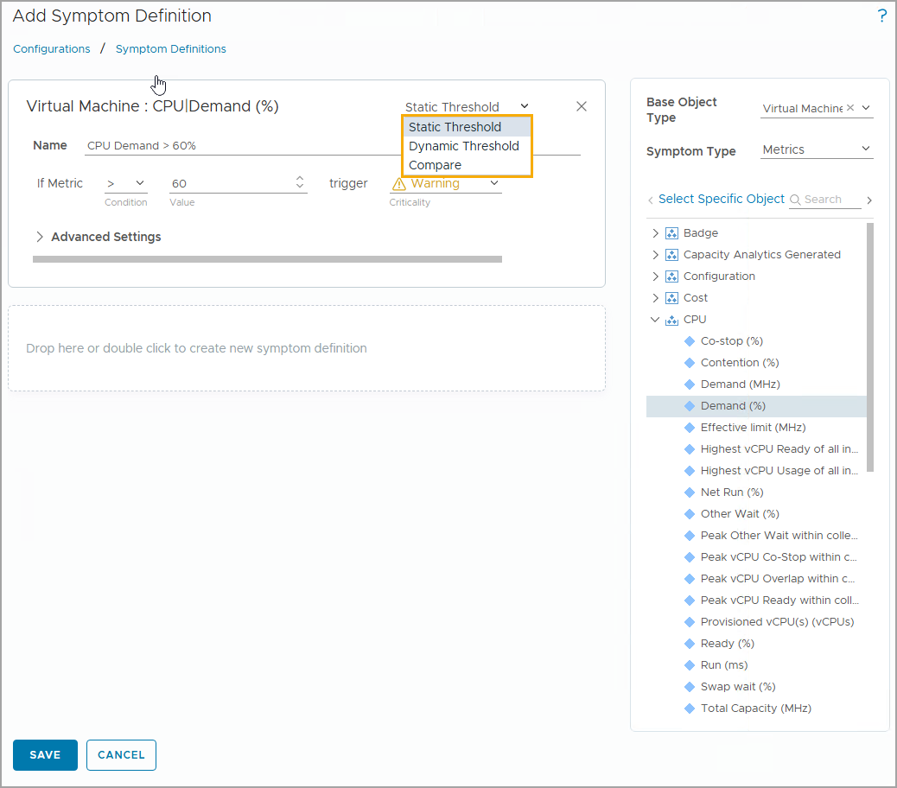
Understanding Threshold Types
A threshold marks the boundary between normal and abnormal behavior for a metric. You need to configure the threshold for each added symptom.
You can choose the following types of thresholds:
Static Threshold
Dynamic Threshold
Compare
Notes:
TalkTrack:
Thresholds are crucial for defining the boundaries between normal and abnormal behavior for a given metric. For every symptom added, a threshold must be configured. There are three main types of thresholds to choose from. The first is a static threshold. This is a fixed value that, when crossed, triggers the symptom. The second type is a dynamic threshold. This threshold adapts over time based on historical data and observed patterns, allowing for more nuanced detection of anomalies. The third option is a compare threshold. This type of threshold allows for the comparison of a metric against another metric, or against a predefined baseline. When configuring a symptom definition, different conditions can be set depending on the chosen threshold type. For example, if a static threshold is selected, the condition statement presented in the configuration window will correspond to that type. Changing the threshold type will alter the available conditions, ensuring that the configuration options are always relevant to the chosen threshold methodology.
<End>
You configure different conditions depending on the threshold type. In this example, the condition statement is for a static threshold. Selecting a different threshold type changes the condition presented in the configuration window.

Slide 25
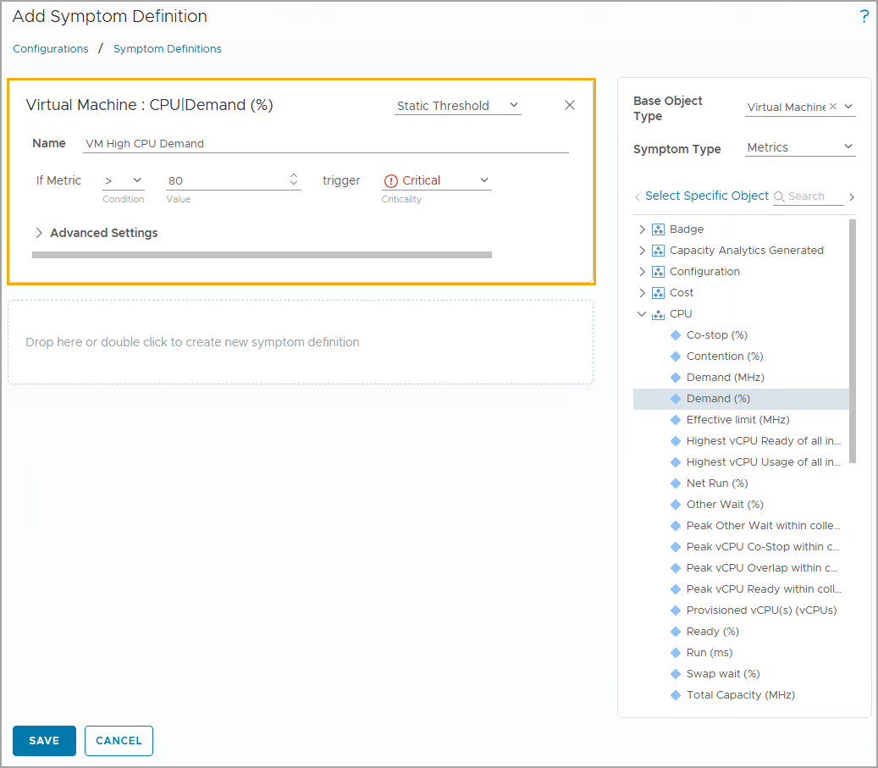
Configuring a Static Threshold
A static threshold compares the currently collected metric value against the fixed value that you configure in the symptom definition.
For a symptom with a static threshold, you must configure the following settings:
Symptom Name
Condition
Value
Criticality
For example, you can configure a static metric symptom. When the virtual machine CPU workload is greater than 70, a critical symptom is triggered. You can select the criticality of the triggered symptom.
Notes:
TalkTrack:
Configuring a static threshold involves comparing the currently collected metric value against a fixed value. This fixed value is precisely what is configured in the symptom definition. For any symptom that utilizes a static threshold, several settings need to be configured. First, the symptom name must be defined. This is the name that will appear in the symptom list when the alert is generated, and it is how the triggered symptom will be viewed. For example, the name might be "VM High CPU Demand." Next, the condition must be specified. This determines how the measured value is compared to the specified threshold. For instance, in the case of a "Virtual Machine CPU Demand (%)" metric, a symptom would be triggered if the value is greater than 70 percent. Finally, the value itself is configured. This is the specific numerical threshold. In the given example, the value of 70 percent represents the critical threshold for CPU demand. Additionally, a criticality level can be assigned. This determines the severity of the symptom, with options such as "Info", "Warning", "Immediate", and "Critical". This level is designated as critical in this example.
<End>
The threshold type indicates whether the symptom is static, dynamic, or compare. In this example, the default Static Threshold is selected.
Symptom name: Name of the symptom as it appears in the symptom list when you configure an alert definition, when the alert is generated, and when you view the triggered symptoms. In the example, the name of the symptom is VM High CPU Demand.
Condition: Determines how your specified value is compared to the current value of the metric (or super metric) when the symptom is evaluated. In this example, if the current Virtual Machine CPU|Demand (%) metric value is greater than 70, a symptom will be triggered.
Value: Specifies the triggering threshold. Every metric has a value type. In the example, the value type for the metric CPU Demand (%) is a numeric value 70 (70%).
Criticality: Severity of the symptom when it is triggered. The criticality values are Info, Warning, Immediate, and Critical. The example symptom here would typically be designated as Critical.

Slide 26
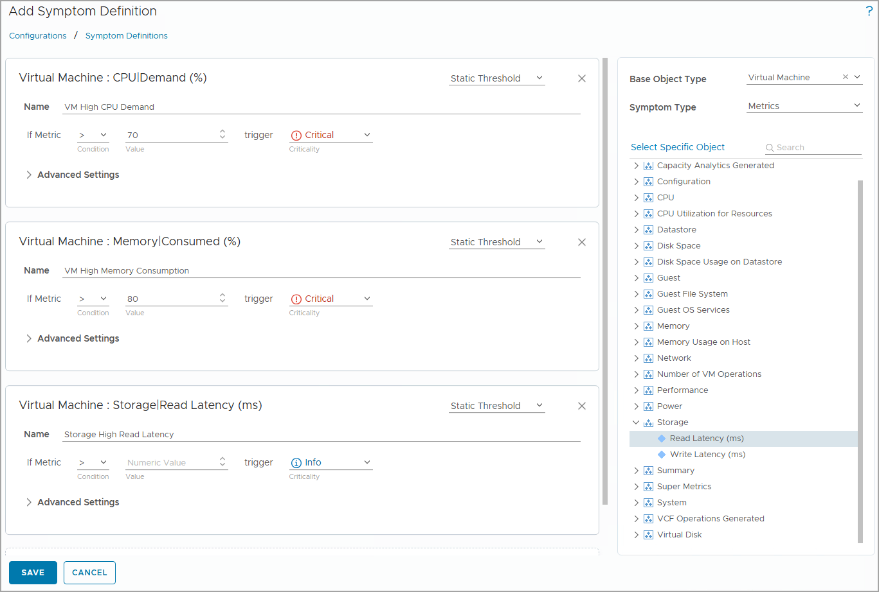
Configuring Multiple Symptom Definitions
If you add multiple symptoms to a symptom definition, you must configure the threshold setting for all the symptoms.
Notes:
TalkTrack:
When dealing with multiple symptom definitions, if additional symptoms are added to an existing symptom definition, it becomes necessary to configure the threshold setting for each of these newly added symptoms. Consider an example where separate symptom definitions are created to monitor different aspects of a virtual machine's performance. One symptom, "Critical CPU Demand %", is set to a critical level. This symptom triggers when the CPU demand exceeds 70 percent. This indicates a high workload that needs attention. Another symptom, "Critical Memory Consumed %", is set to an immediate level. This symptom is triggered when memory consumption goes above 80 percent, signaling a more urgent resource issue. Finally, there's a symptom for "Storage Read Latency in ms". This symptom still needs to be further defined. This highlights that while the symptom has been added, its specific triggering conditions and thresholds are yet to be configured. This modular approach allows for comprehensive monitoring by combining multiple conditions into a single alert definition.
<End>
In the example, the following separate symptom definitions are created:
Critical CPU Demand %: Symptom is set to the critical level when the CPU demand is greater than 70 percent.
Critical Memory Consumed %: Symptom is set to the immediate level when the memory consumption is greater than 80 percent.
Storage Read Latency in ms: Symptom still needs to be further defined.

Slide 27
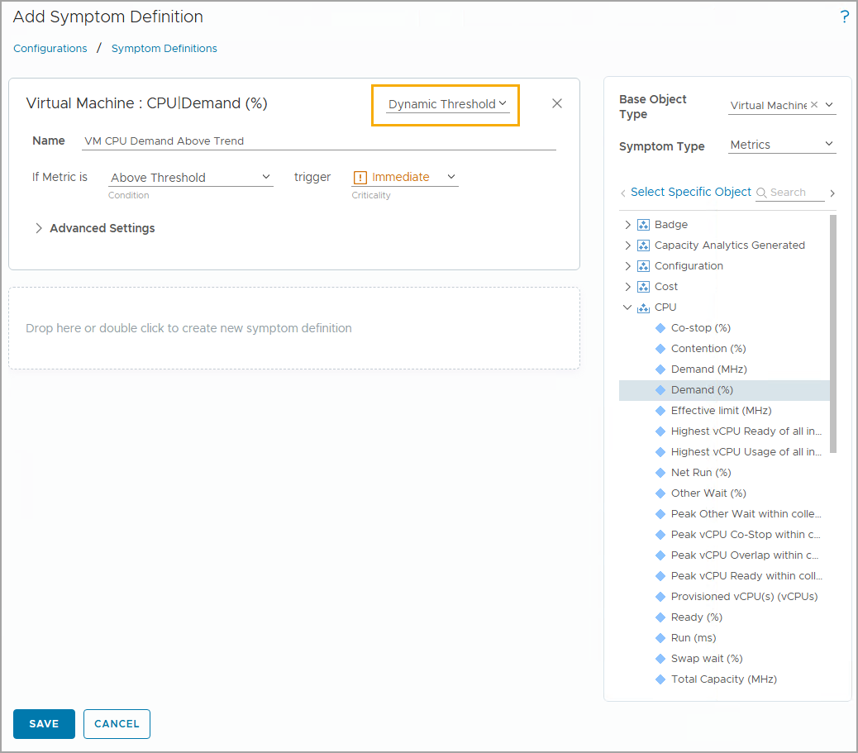
Configuring a Dynamic Threshold
A dynamic threshold is based on VCF Operations Dynamic Threshold calculation values, which are calculated by the analytics components daily. The triggering value is determined through analytics.
The following values define the relationship of the current value to the trend range:
Above Threshold: If the current value is above the trend range, the symptom is triggered.
Below Threshold: If the current value is below the trend range, the symptom is triggered.
Abnormal: If the current value is either above or below the trend range, the symptom is triggered.
Notes:
TalkTrack:
Dynamic thresholds provide a sophisticated method for monitoring metrics. Unlike static thresholds, which use a fixed value, dynamic thresholds are based on VCF Operations dynamic threshold calculation values. These values are computed daily by the analytics components of the system. The triggering value for a dynamic threshold is determined through this ongoing analytics process. The relationship between the current value and the trend range defines how a dynamic symptom is triggered. If the current value is above the trend range, the symptom is triggered as "Above Threshold". This indicates that the metric is performing unusually high compared to its historical pattern. Conversely, if the current value falls below the trend range, the symptom is triggered as "Below Threshold". This suggests that the metric is performing unusually low, which could also indicate an issue. Finally, if the current value is either above or below the trend range, the symptom is triggered as "Abnormal". This broad category captures any significant deviation from the established normal behavior. The analytics component of VCF Operations automatically runs the dynamic threshold calculation every night at 2 AM local time. If the current value of the metric or property is detected to be above or below its calculated dynamic threshold, then the symptom is triggered. It is also possible to manually recalculate dynamic thresholds. This can be done by navigating to Administration, then Control Panel, then Dynamic Thresholds, and clicking "Start". This provides flexibility for recalculating thresholds on demand.
<End>
The analytics component of VCF Operations runs the dynamic threshold calculation every night at 2 AM local time. If the current value of the metric or the property is above or below the dynamic threshold, the symptom is triggered.
Dynamic Threshold can also be manually recalculated by navigating to Administration > Control Panel > Dynamic Thresholds, and clicking Start.

Slide 28
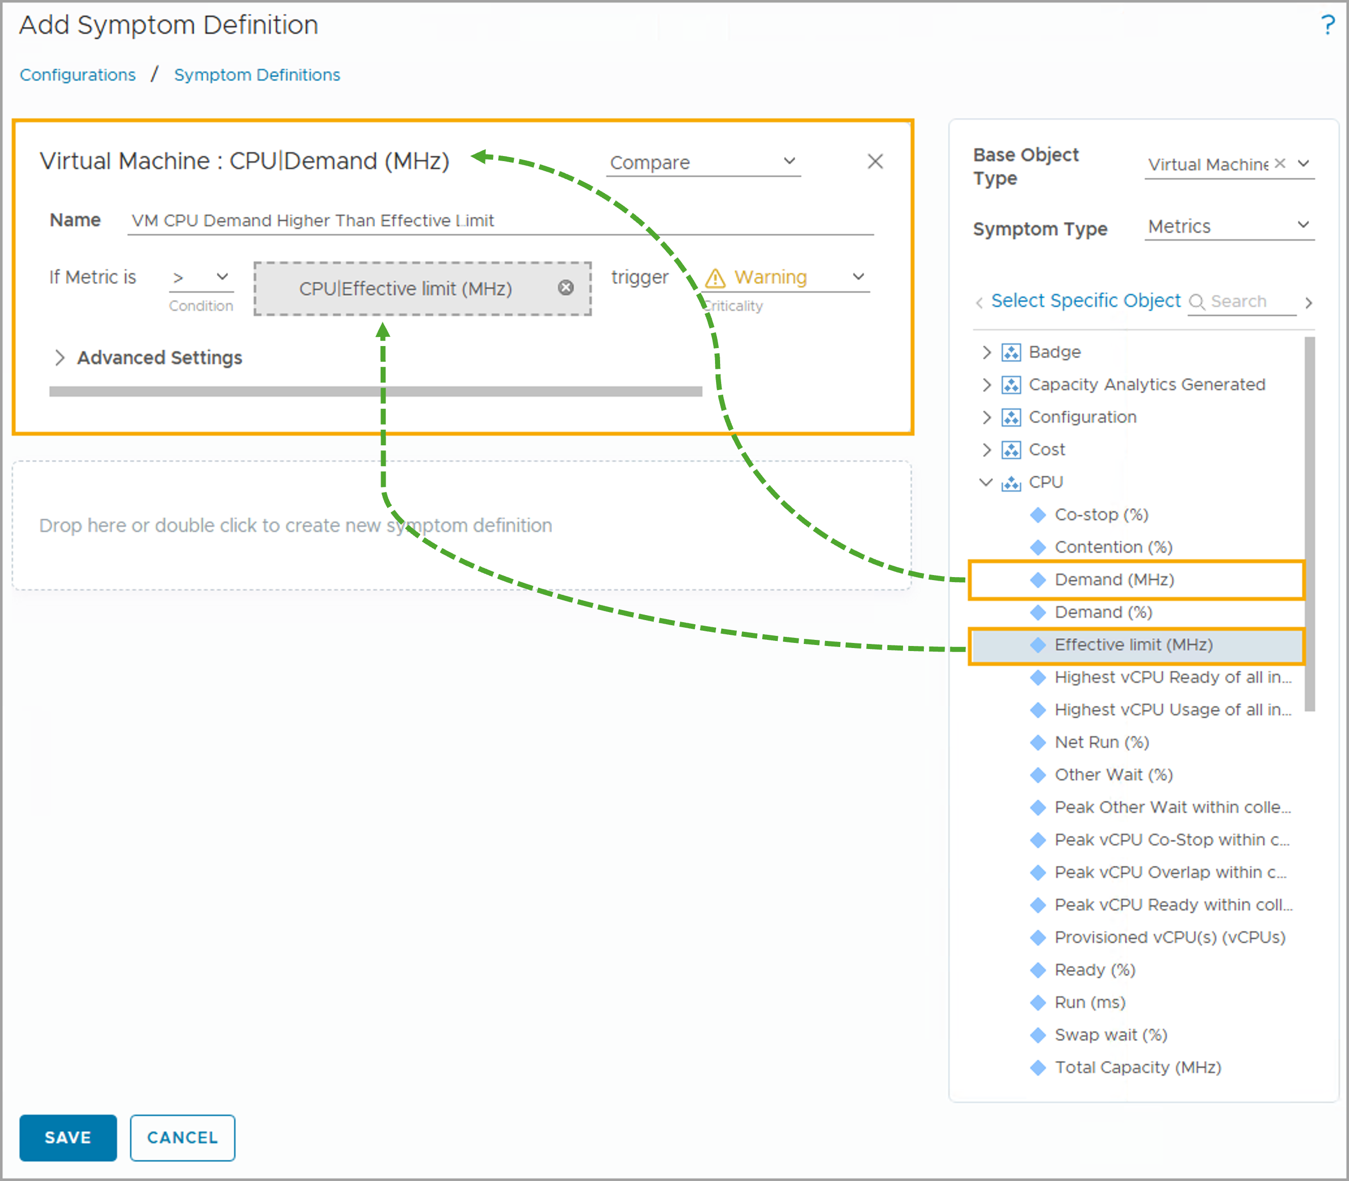
Configuring a Compare Threshold
A compare threshold is based on the comparison of two metrics.
Example comparisons that you can evaluate using the greater than symbol (>) include:
CPU Demand > CPU Entitlement
Memory Demand > Memory Use
Notes:
TalkTrack:
Configuring a compare threshold allows for the comparison of two metrics to determine a symptom's trigger. Example comparisons that can be evaluated using a "greater than" symbol include comparing CPU Demand against CPU Entitlement. Another example is comparing Memory Demand against Memory Use. When using a compare threshold, the symptom will have a name and criticality similar to a static threshold. However, the first condition involves comparing the selected metric to a metric value. In contrast, for a compare threshold, the comparison is made against another metric or property. To implement this, a second metric can be dragged into the gray area of the configuration. In an example, by dragging the metric "CPU Effective Limit (MHz)" to the comparison value area and selecting the "greater than" symbol (>), the system evaluates whether the metric "CPU Demand (MHz)" is greater than the CPU entitlement. This creates a powerful and flexible way to define symptoms based on relative performance or resource utilization.
<End>
A compare threshold has a symptom name and criticality similar to the static threshold. However, in the test condition, instead of comparing the selected metric to a numeric value, you compare it to another metric or property. You can drag a second metric from the metric list to the gray area. In the example, by dragging the metric CPU Effective limit (MHz) to the comparison value area and using the greater-than symbol (>), you evaluate whether the metric CPU Demand (MHz) is greater than the CPU Entitlement.

Slide 29
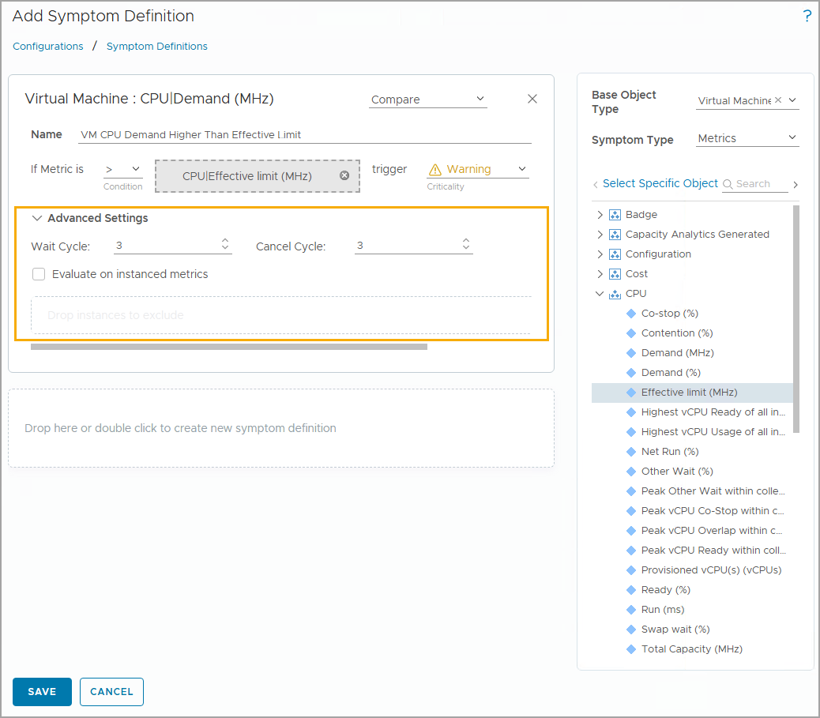
Configuring Symptom Wait and Cancel Cycles
For each symptom, you can click Advanced to show the following additional configurations:
Wait cycle: The test condition must remain true for a fixed number of polling cycles before the symptom is triggered.
Cancel cycle: The symptom is canceled after the test condition is false for a fixed number of polling cycles.
Notes:
TalkTrack:
When configuring a symptom, it is possible to define additional criteria using wait and cancel cycles. These provide more control over when a symptom is actually triggered or dismissed. These are accessed through the "Advanced Settings". The wait cycle is a specific condition. The symptom's condition must remain true for a fixed number of polling cycles before the symptom is officially triggered. This helps to prevent transient issues from generating unnecessary alerts. Conversely, the cancel cycle determines when a symptom is dismissed. The symptom is considered resolved if the trigger condition is false for a fixed number of polling cycles. This ensures that an alert is not prematurely cleared if the condition is still flapping. For example, a default wait cycle of three polling cycles means the symptom condition must be true for three consecutive monitoring intervals before it triggers. Similarly, a default cancel cycle of three polling cycles means the symptom condition must be false for three consecutive intervals before the symptom is cleared. This fine-tuning ensures that alerts are meaningful and persistent, avoiding false positives or rapid, misleading clearings.
<End>
You can configure the wait cycle and cancel cycle for a symptom based on your requirement.
The wait cycle indicates that the trigger condition must remain true for the specified number of collection cycles before the symptom is triggered.
The cancel cycle indicates that the symptom is canceled after the trigger condition is false for the specified number of collection cycles, after which the symptom is canceled.
If you select Evaluate on instanced metrics, the symptom is evaluated using all the objects instead of an aggregated value. In the example, assuming the default collection cycle is 5 minutes, the virtual machine’s CPU demand metric value must remain above the effective limit for three wait cycles (3 * 5 = 15 minutes) before the symptom is triggered. The symptom is canceled only after the virtual machine’s CPU demand metric value stays equal to or below the effective limit for three cancel cycles (15 minutes).

Slide 30
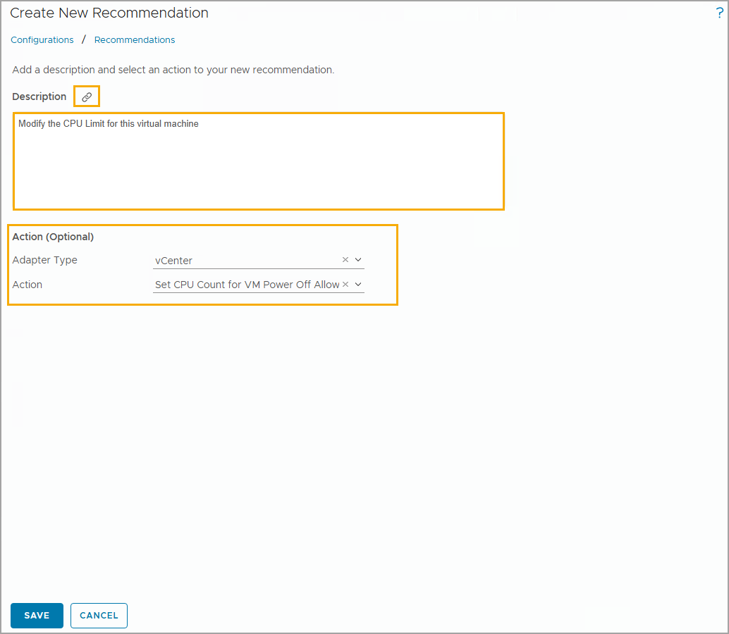
Viewing and Creating Recommendations
A recommendation can be a user-defined text. A recommendation can also include HTML links to the external resources such as knowledge base articles.
To view all recommendations in your VCF Operations console, navigate to Infrastructure Operations > Configurations > Recommendations.
The recommendation list displays all predefined and custom-built recommendations. To add a new custom recommendation, click ADD.
A recommendation can include an optional action.
Notes:
TalkTrack:
Recommendations are a core component of alert definitions. A recommendation offers a probable solution to the problem that initially triggered the alert. They are designed to guide users towards resolving issues. A recommendation can contain various types of helpful information. This includes best practices, which provide general guidance for addressing common issues. Vendor recommendations are also often included. These are specific solutions or advice provided by the hardware or software vendor. Additionally, recommendations can provide direct links to troubleshooting resources. These links can point to documentation, knowledge base articles, or other helpful materials. The system allows for the use of built-in recommendations provided by VCF Operations. However, there is also the flexibility to create custom recommendations, tailored to unique environmental needs or operational procedures. An alert can have zero or more recommendations associated with it. The text of a recommendation clearly outlines the necessary steps to resolve the triggered alert. Without these recommendations, an administrator or operator would lack clear guidance on how to address a problem. For example, a recommendation might list a series of steps that an administrator or operator should perform to resolve the issue. It could also provide specific instructions, such as notifying a virtual infrastructure administrator when a problem occurs. This customization allows for the creation of specific recommendations, which can then be added to an alert definition, ensuring that if a suitable recommendation does not already exist, it can be created and applied.
<End>
The recommendation text box allows you to enter the description of the recommendation. You can include hyperlinks in the text box. For example, you might provide a hyperlink to the VMware documentation or a local wiki page. To include a hyperlink, you enter the text in the text box, select the text, and click Create a hyperlink to make the text a hyperlink. In the example, the recommendation is a plain text string: Modify the CPU limit for this virtual machine. You can add a URL by clicking the hyperlink icon in the Create New Recommendation dialog box. You can also add actions to the recommendation.

Slide 31
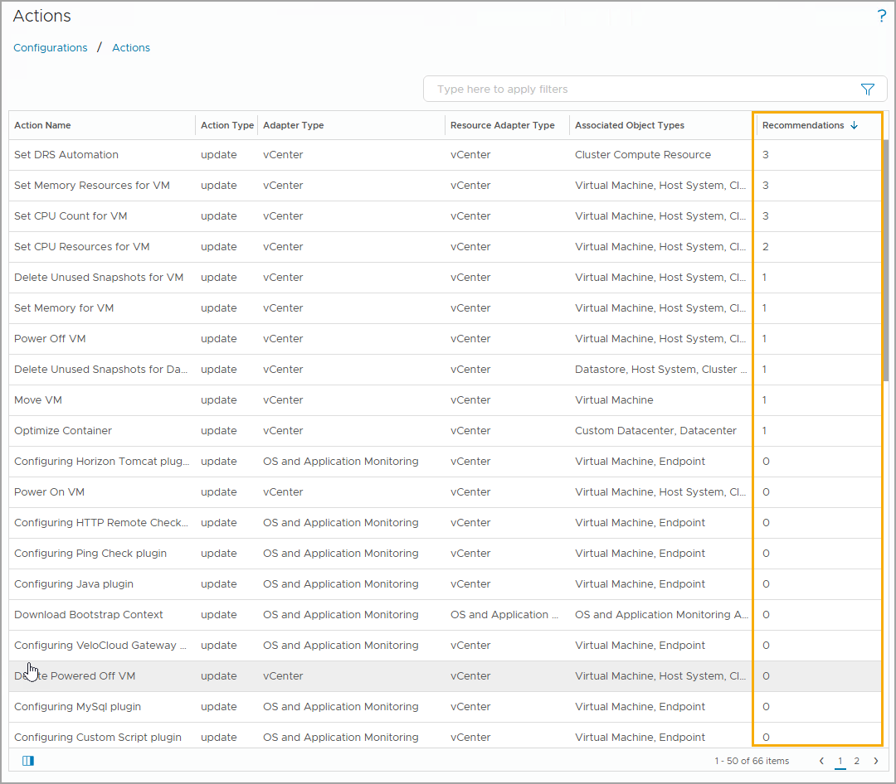
Viewing the Inbuilt Actions
The Actions overview is a list of actions available in your environment that can be added to alert recommendations.
To view all the actions in your VCF Operations console, navigate to Infrastructure Operations > Configurations > Actions.
The number of times an action has been assigned to a recommendation is recorded in the Recommendations column.
Notes:
TalkTrack:
Inbuilt actions are pre-configured operations that are included in the VCF Operations environment and can be readily added to alert recommendations. To view these built-in actions, navigate within the VCF Operations console to Infrastructure Operations, then Configurations, and finally Actions. This section lists all available actions. When an action is assigned to a recommendation, it appears within the recommendation details, making it easy to see which automated tasks are linked to specific problem resolutions. Actions can change the state of an object from VCF Operations. Consider how actions work with alerts. An action might be associated with a recommendation and is typically initiated with a single click. It is important to remember that an action is always performed on the selected object. Not all alerts will necessarily have an action associated with them. For example, two highlighted actions could be assigned to a recommendation as part of an alert definition. This means that when the alert triggers, these specific actions become available to help resolve the issue. Inbuilt actions support parameters that allow for configuration, such as setting timeouts, delaying operations, and configuring retry and memory settings. Update actions modify data or objects in monitored systems and are commonly provided as part of a solution, often a native management pack configuration. These are accessible from the object actions menu found under the objects page. Actions can also be added directly to alert definition recommendations. Read actions, on the other hand, simply retrieve data from target objects, providing information without making changes. When using actions that involve powering off a virtual machine, it is critical to understand the impact of such an operation on the engine. Always confirm that VCF Operations has the necessary permissions to perform the action before selecting the best options for target virtual machines.
<End>
When you run an action, you change the state of an object from VCF Operations.
Consider the following details when configuring actions with alerts:
An action can be associated with a recommendation and is initiated by a single click.
An action can also be performed out of an alert on the selected object.
Not all alerts have an action.
You can run an action as a part of an alert recommendation. In this example, the two highlighted actions have been assigned to a recommendation. You can also run an action from the Actions drop-down menu of an object on which you work. In-built actions are available, such as powering on and off VMs, deleting VMs, shutting down a VM, and setting CPU and memory settings. Recommendations can identify ways to remediate problems indicated by an alert. Remediations can be associated with actions defined in your VCF Operations instance. Working with actions that use power off: Some actions provided with VCF Operations require the virtual machines to shut down or power off, depending on the configuration of the target machines, to run the actions. You must understand the impact of the Power Off Allowed option before running the actions so that you select the best options for your target virtual machines.

Slide 32
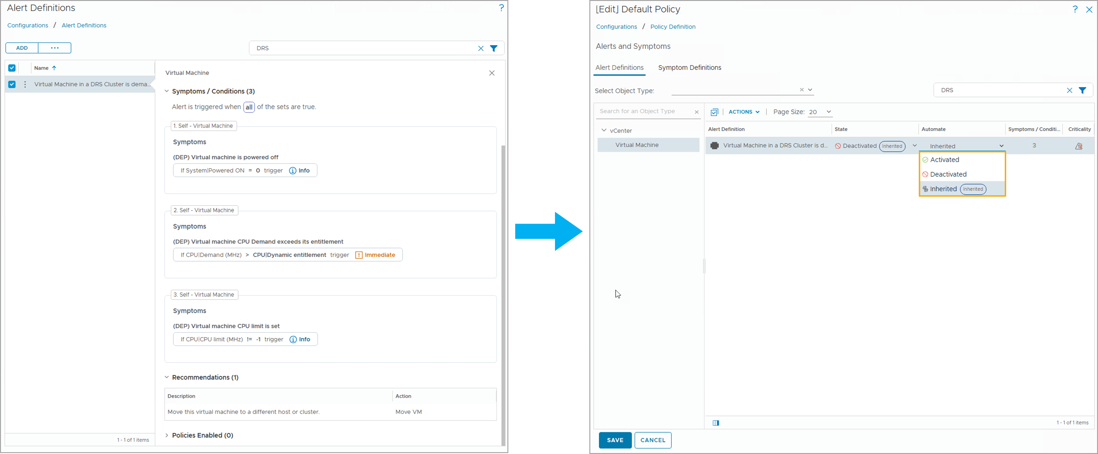
Automation Action Framework
You can configure actions to be triggered from alert recommendations automatically. As they are disabled by default, you must enable the action in the object's associated policy.
Notes:
TalkTrack:
The Automation Action Framework in VCF Operations allows actions to be automatically triggered based on alert recommendations. By default, this feature is disabled. Therefore, to use it, the action must be explicitly enabled within the object's associated policy. Automation can be configured for alert recommendations when the recommendation is prioritized for that alert. Several virtual machine actions are supported for automation. These include deleting a powered-off virtual machine, deleting an idle virtual machine, or moving a virtual machine. Other supported actions involve power operations, such as powering off a virtual machine or powering on a virtual machine. Resource adjustments are also supported. This includes setting the CPU count and memory for a virtual machine, and similar settings with the option for power off being allowed. It also covers setting just the CPU count, with or without power off allowance. Further resource management includes setting resources for a virtual machine, setting memory, and setting memory with power off allowed. There is also an option for setting memory resources. Finally, the framework supports shutting down the guest operating system for a virtual machine.
<End>
You can automate remediation actions for an alert when the recommendation is the priority for that alert.
The following VM actions are supported for automation:
Delete Powered Off VM.
Delete Idle VM.
Move VM.
Power Off VM.
Power On VM.
Set CPU Count And Memory for VM.
Set CPU Count And Memory for VM Power Off Allowed.
Set CPU Count for VM.
Set CPU Count for VM Power Off Allowed.
Set CPU Resources for VM.
Set Memory for VM.
Set Memory for VM Power Off Allowed.
Set Memory Resources for VM.
Shut Down Guest OS for VM.

Slide 33
Lab: Creating Custom Symptoms
Create and test symptom definitions:
Prepare for Event and Log Collection
Create a Symptom Definition to Check for Medium CPU Demand of a VM
Create a Symptom Definition to Check for High CPU Demand of a VM
Create a Symptom Definition to Check for High CPU Demand of a Host System
Enable Custom Symptoms in the Policy
Test the Symptom Definitions

Slide 34
Review of Learner Objectives
Create static symptom definitions
Configure different threshold types for symptoms
Configure recommendations and actions for an alert

Slide 35
Creating Custom Alert Definitions

Slide 36
Learner Objectives
Configure a custom alert using the Create Alert Definition workflow
Add symptoms, conditions, and recommendations to an alert definition
Create notifications for a custom alert definition

Slide 37
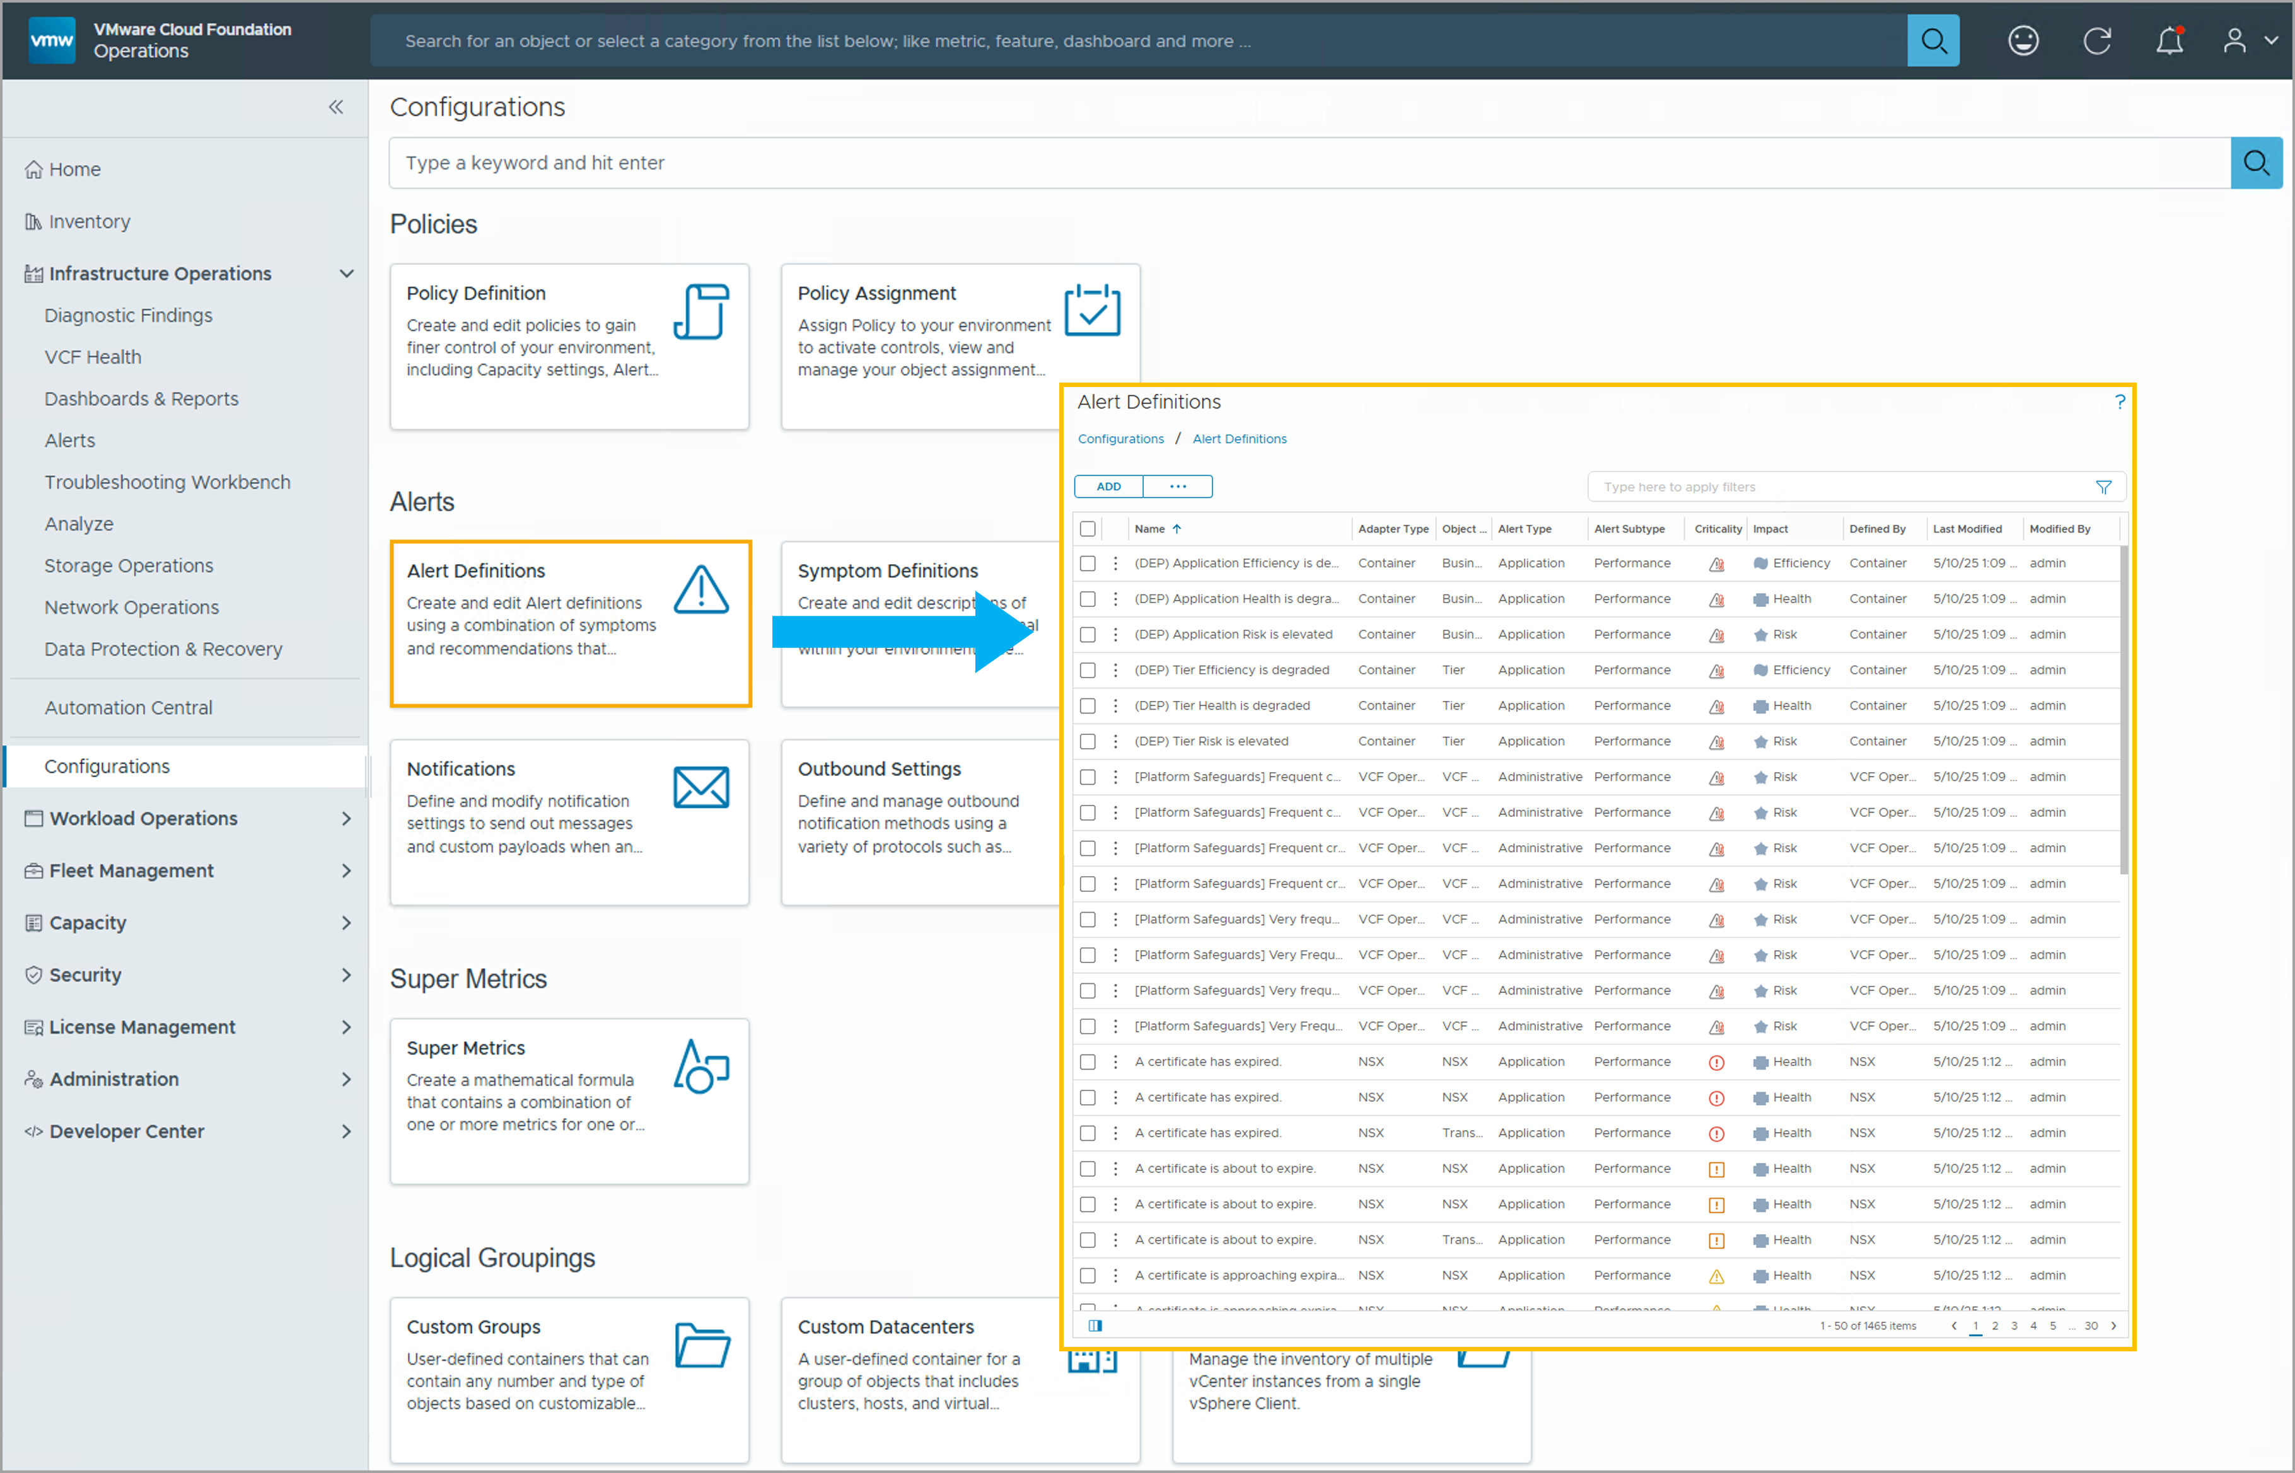
Viewing Alert Definitions
The Alert Definitions page lists all the alert definitions configured for your environment. To view alert definitions, navigate to Infrastructure Operations > Configurations > Alert Definitions.
Notes:
TalkTrack:
Alert definitions provide a comprehensive configuration for alerts within VCF Operations. To view all configured alert definitions for an environment, navigate to Infrastructure Operations, then Configurations, and finally Alert Definitions. The Alert Definitions pane lists all the defined alerts. The "Object type" column displays the base object type for each alert. The "Defined by" column shows the creator of the alert. Predefined alerts are included in VCF Operations as part of configured adapters. The Alert Definitions page is a central management area for the VCF Operations alert library. It allows for adding or modifying alert definitions.
<End>
The Alert Definitions pane lists all the alert definitions. The Object Type column displays the alert base object type. The Defined By column displays the creator of the alert. Predefined alerts are provided in VCF Operations as part of your configured adapters. Use the Alert Definitions page to manage your VCF Operations alert library, and to add or modify the definitions.

Slide 38
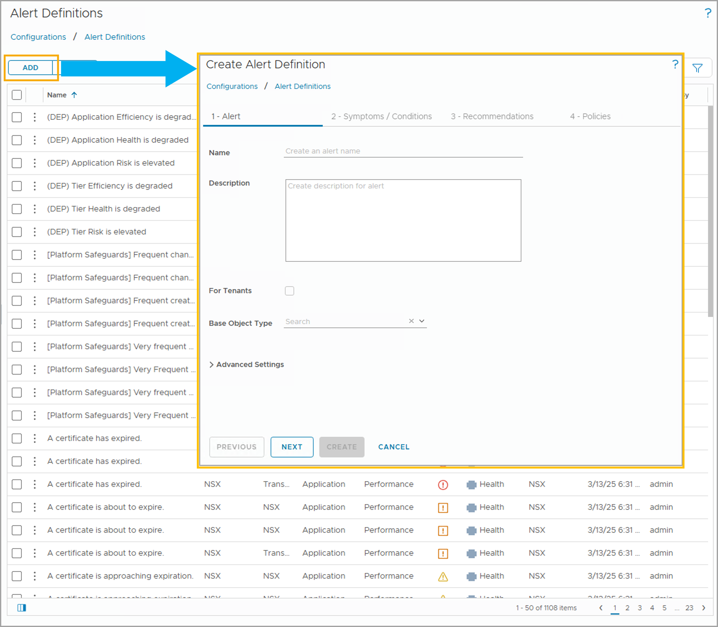
Alert Definition Creation Workflow
The alert definition creation process includes adding symptoms that trigger an alert and recommendations that help resolve the alert. To add a new alert definition, click ADD.
To create an alert definition, you must complete the following tasks in the Alert Definition Creation wizard and VCF Operations console:
Configure an alert name, description, base object type, and advanced settings.
Add or create one or more symptom definitions.
Add or create one or more recommendations.
Specify the policies where the alert is used.
Add notifications (completed from Infrastructure Operations > Configurations > Notifications).
Notes:
TalkTrack:
The alert definition creation process involves several key steps that integrate symptoms and recommendations to resolve issues. To add a new alert definition, click the "Add" button. The first step is to configure the alert. This includes assigning a name, providing a description, selecting the base object type, and setting any advanced options. Next, add one or more symptom definitions. These are the specific conditions that will trigger the alert. Following this, add one or more recommendations. These provide guidance on how to address the problem identified by the alert. Specify the policies that will apply to this alert. Policies define how data is collected, displayed, and analyzed, influencing the alert's behavior. Finally, add notifications. These are configured through Infrastructure Operations, then Configurations, and then Notifications, ensuring that relevant parties are informed when the alert triggers. An alert definition can be created to address a problem based on its root cause and the available solutions. For instance, if an alert is triggered on a host system, VCF Operations provides alerts and recommendations to help resolve the issue. Before implementing any new critical capacity problems and VCF Operations notify problems, create alert definitions and add symptom definitions to the alert definition.
<End>
Based on the root cause of the problem and the solutions that are used to fix the problem, you can create an alert definition for VCF Operations to create an alert. When the alert is triggered on the host system, VCF Operations alerts and provides recommendations to solve the problem. To alert you before host systems experience critical capacity problems and have VCF Operations notify problems in advance, you create alert definitions and add symptom definitions to the alert definition.

Slide 39
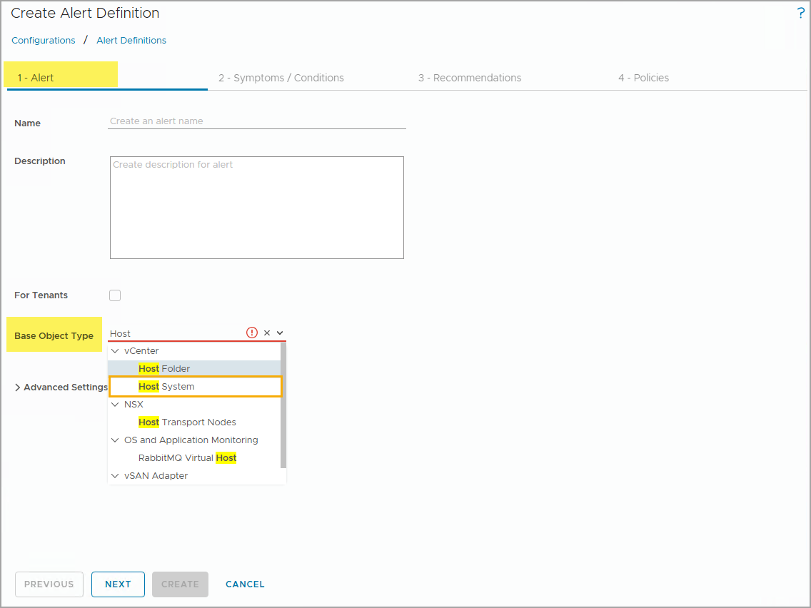
Selecting the Base Objective Type
The base object is the object around which the alert definition is created. In the example, the base object type is Host System.
The base object types for the alert definition and the symptom definitions need not match. The base object types must be related in the inventory tree.
Notes:
TalkTrack:
An alert definition is always associated with a base object type. The alert definition is evaluated against objects that match this base object type. The base object is the object against which the alert definition is created. For example, the base object type could be a Host System. The base object types for the alert definition and the symptom definitions do not always need to match. The base object types must be related within the inventory tree. Objects are displayed by adapters and containers. It is also possible to search for a particular object type. For example, if the base object type for the alert definition is a host system, then the base object type for its symptom definition could be a host system, virtual machine, or datastore. Virtual machine and datastore are child object types of the host system in the vSphere inventory tree.
<End>
An alert definition is associated with a base object type. The alert definition is evaluated against objects that match the base object type. Object types are displayed by adapters and containers. You can also search for a particular object type. The base object types must be related. For example, if the base object type for the alert definition is host system, then the base object type for its symptom definition can be a host system, virtual machine, or datastore. Virtual machine and datastore are child object types of the host system in the vSphere inventory tree.

Slide 40
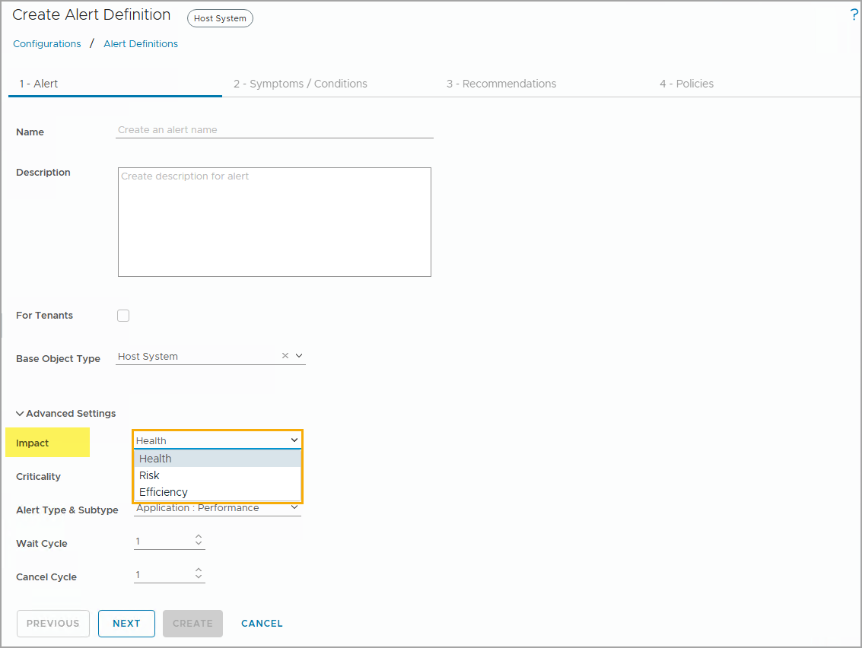
Advanced Settings: Selecting the Impact of the Alert
To reveal additional Alert Definition settings, you can click Advanced to expand more settings.
You use the Impact setting to specify the badge with which you associate the alert. The following settings are available:
Health: Alert requires immediate attention.
Risk: Alert must be addressed soon after it is triggered, either in days or weeks.
Efficiency: Alert must be addressed in the long term to optimize your environment.
Notes:
TalkTrack:
To reveal additional alert definition settings, click "Advanced" to expand more options. The "Impact" setting specifies the badge with which the alert is associated. There are three available settings: First, "Health" indicates that the alert requires immediate attention. This signifies a critical issue impacting the health of the monitored system. Second, "Risk" means the alert must be addressed soon after it is triggered, typically within days or weeks. This points to a potential problem that could escalate if not handled. Third, "Efficiency" implies the alert must be addressed in the long term to optimize the environment. These alerts are less urgent but contribute to overall system improvement.
<End>

Slide 41
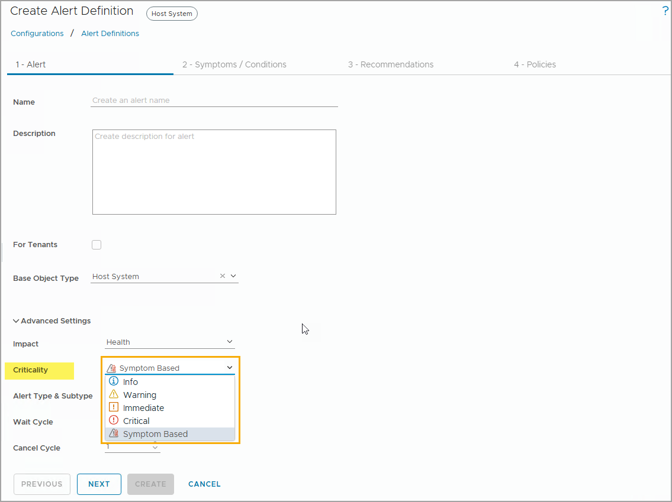
Advanced Settings: Selecting the Criticality of the Alert
You use the Criticality setting to define the alert severity. The following settings are available:
Info
Warning
Immediate
Critical
Symptom Based
Alert criticality determines the Health, Risk, and Efficiency badge colors.
Notes:
TalkTrack:
The criticality setting defines the alert severity. Several levels are available for selection. "Info" provides basic informational alerts. "Warning" indicates a condition that warrants attention but is not immediately critical. "Immediate" signifies a more urgent situation requiring prompt action. "Critical" denotes the highest severity, demanding immediate and critical attention to resolve the issue. Additionally, "Symptom Based" can be chosen as a criticality setting. If selected, the alert's overall criticality is determined by the worst (highest) criticality of all triggered symptoms within that alert. The criticality setting directly impacts the Health, Risk, and Efficiency badge colors displayed in VCF Operations, providing a visual indicator of the alert's severity. The criticality setting indicates the severity of the alert as communicated through the alert notification.
<End>
The Criticality setting indicates the severity of the alert that is communicated as part of the alert notification. In addition to alert criticality, each symptom includes a defined criticality. If you select Symptom Based, the alert criticality is determined by the worst criticality of all the triggered symptoms.

Slide 42
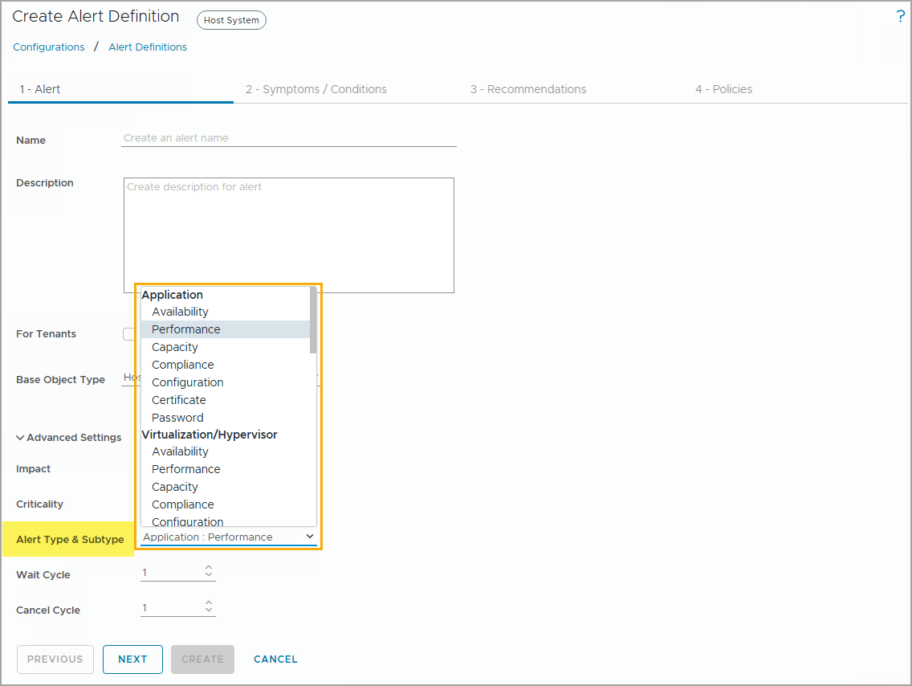
Advanced Settings: Selecting the Alert Types and Subtypes
Alert types and subtypes categorize the alert. They are useful when filtering or sorting alerts in the user interface.
Notes:
TalkTrack:
Alert types and subtypes are used to categorize the generated alerts. This categorization is useful for filtering and sorting alerts within the user interface. The alert type and subtype information can be used to route the alert to the appropriate personnel and department in the organization, ensuring the right teams are notified for specific issues. Several alert types are available: "Application", "Virtualization/Hypervisor", "Hardware (OSI)", "Storage", "Network", "Administrative", and "Findings". Each alert type has its own set of subtypes, covering areas such as "Availability", "Performance", "Capacity", "Compliance", and "Configuration". For example, if the alert type is "Application", a corresponding subtype could be "Performance", indicating an application performance issue.
<End>
Alert types and subtypes are used to classify the generated alert. The Alert type and subtype information can be used to route the alert to the appropriate personnel and department in your organization.
The following alert types are available:
Application
Virtualization/Hypervisor
Hardware (OSI)
Storage
Network
Administrative
Findings
Each alert type has the same set of subtypes: Availability, Performance, Capacity, Compliance, and Configuration. In the example, the alert type is Application and the subtype is Performance.

Slide 43
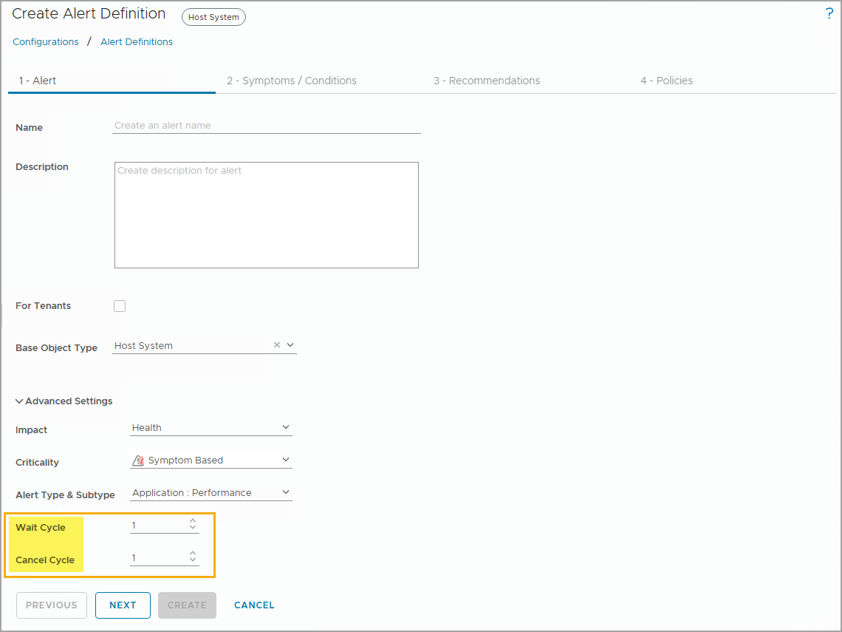
Advanced Settings: Configuring the Alert Wait Cycles and Cancel Cycles
The Wait Cycle determines when an alert is generated. The symptoms included in the alert definition remain triggered for the number of collection cycles before the alert is generated.
The Cancel Cycle determines how long an alert remains active. The alert is not canceled until the number of polling cycles has passed, after the last symptom is detected.
Notes:
TalkTrack:
The wait cycle determines how long an alert remains active. The symptoms included in the alert definition must remain triggered for a specific number of collection cycles before the alert is actually generated. Conversely, the cancel cycle defines how long an alert remains active. An alert is not canceled until a specified number of polling cycles have passed, after the last symptom is detected. The normal polling cycle for adapters is five minutes. An alert triggers when the symptom conditions remain true for X number of wait cycles. For example, the conditions must remain true for five minutes (one wait cycle) before the alert triggers. An alert remains active until the symptoms' test conditions remain false for X number of cancel cycles. For instance, the symptoms' test conditions must remain false for five minutes (one cancel cycle) before the alert is canceled.
<End>
The normal polling cycle for adapters is 5 minutes. An alert is triggered when the symptoms remain true for X number of wait cycles. In the example, the conditions must remain true for 5 minutes (one wait cycle) before the alert is triggered. An alert remains active until the symptoms’ test conditions remain false for X number of cancel cycles. In the example, the symptoms' test conditions must remain false for 5 minutes (1 cancel cycle) before the alert is canceled.

Slide 44
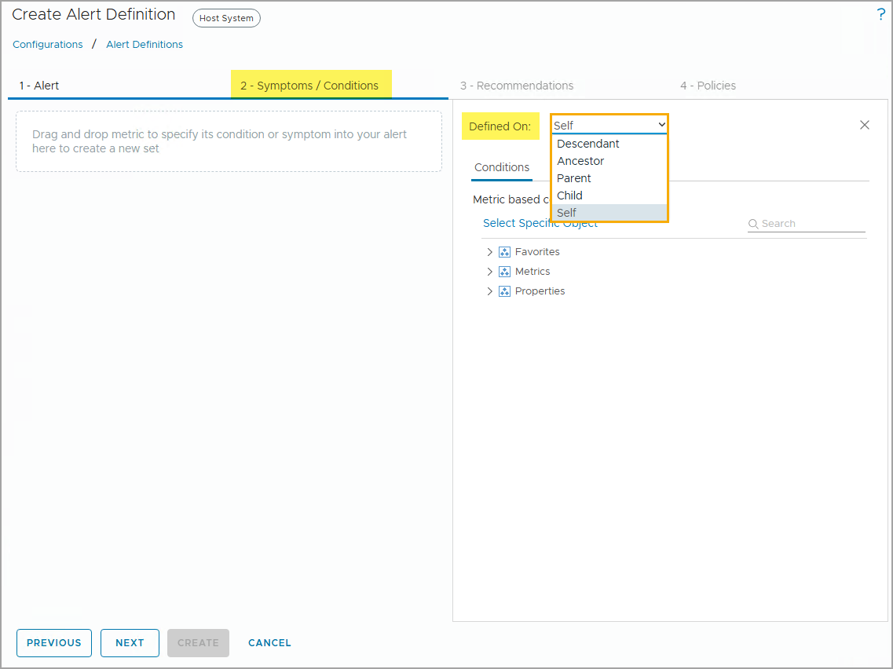
Configuring Alert Evaluation Targets
The Defined On option defines the object type that the symptom evaluates.
The following selections are available:
Descendant: N levels down the tree
Ancestor: N levels up the tree
Parent: One level up the inventory tree
Child: One level down the tree
Self: Symptom base object type, same as the alert base object type
If you do not know the relationships, you can go to the Environment page to view the inventory tree for that object.
Notes:
TalkTrack:
The "Defined On" option specifies the object type that the symptom evaluates. Several selections are available. "Descendant" means the symptom evaluates objects N levels down the tree from the base object. "Ancestor" indicates the symptom evaluates objects N levels up the tree. "Parent" signifies evaluation of objects one level up the inventory tree. "Child" refers to evaluation of objects one level down the tree. "Self" means the symptom evaluates the same base object type as the alert itself.
<End>
In the example, the base object type for the alert definition is Host System. If you select Self as the Defined On value, you get the symptom definitions for Host System as the base object type. You can add these symptom definitions to the alert definition. By selecting Child, you can access other symptoms such as those for virtual machines. You can also create symptom definitions, by clicking Create New Symptom in the Symptoms pane of the Create Alert Definition page.

Slide 45
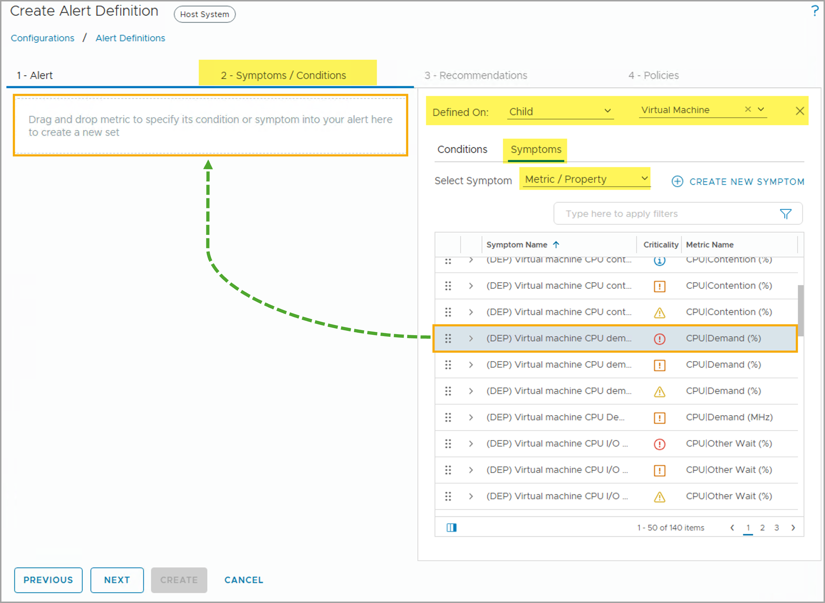
Adding Symptoms to an Alert Definition
An alert definition requires one or more symptoms for an alert definition. To add a symptom, you can drag the desired symptoms from the symptom list to the symptom/condition specification area.
In the example, you can filter the symptom definitions based on child object types of the base object type Host System. Because Child is selected, you can add a virtual machine symptom to the alert definition.
Notes:
TalkTrack:
An alert definition requires one or more symptoms to be added. To add a symptom, drag the desired symptom from the symptom list to the symptom or condition specification area. The symptoms can be filtered based on child object types of the base object type. If "Child" is selected, a virtual machine symptom can be added to a Host System alert definition. The "Defined On" value and the filter by "Object type" determine the symptom definitions available for selection and use for the alert definition. For example, "Virtual Machine CPU Demand" at a critical level is a selected symptom.
<End>
In the example, Child is selected from the Defined On drop-down menu because the base object type for the alert definition is Host System and you are creating alerts for the Virtual Machine object type. You can filter the symptom definitions based on host system child object types, which are Virtual Machine, Datastore, and Resource Pool. " The Defined On value and the Filter by Object Type value determine the symptom definitions that you select and use for the alert definition. In the example, Virtual machine CPU demand at Critical level is selected.

Slide 46
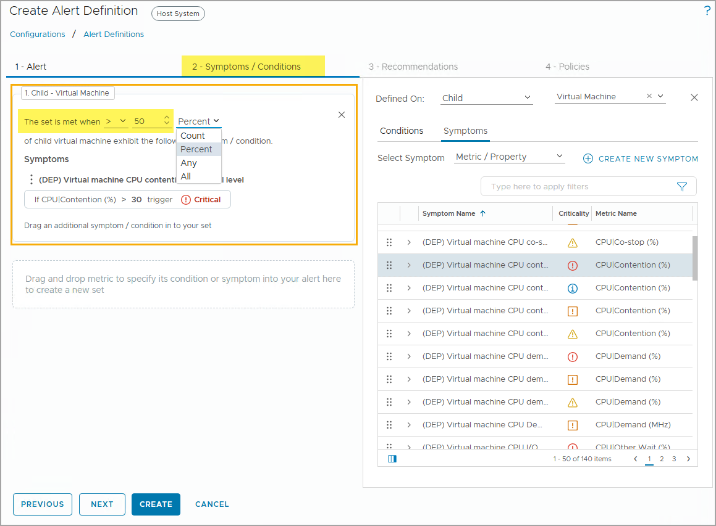
Configuring the Symptom Test Condition
After you add a symptom definition to an alert definition, you must configure the symptom test condition.
You can choose from the following value types:
Count: A specific number of child objects exhibit this symptom.
Percent: A certain percentage of child objects exhibit this symptom.
Any: Any child object can exhibit this symptom.
All: All child objects must exhibit this symptom.
Notes:
TalkTrack:
After adding a symptom definition, configuring the symptom test condition is the next step. There are several value types to choose from when setting the test condition: "Count" specifies that a certain number of child objects must exhibit the symptom. "Percent" indicates that a certain percentage of child objects must exhibit the symptom. "Any" means that any single child object exhibiting the symptom will trigger it. "All" requires that all child objects exhibit the symptom for it to trigger. A symptom set can include one or more symptoms. The symptom set is considered true if one or more child virtual machine objects exhibit any of the symptoms. When multiple symptoms exist, the "Any" and "All" operators are applied between the symptoms in the symptom set. "All" means all symptoms in the set must be present on the child objects. "Any" means any symptom in the set must be present on the child objects. For example, the alert condition would be true if more than 50 percent of the virtual machines on the host have more than 30 percent CPU contention.
<End>
A symptom set can include one or more symptoms. In the example, one symptom is in the symptom set. The symptom set is true when one or more child virtual machine objects exhibit any of the symptoms.
When multiple symptoms exist, the values Any and All are operators applied between symptoms in the symptom set:
All: All symptoms in the set must be present on the child objects.
Any: Any symptom in the set must be present on the child objects.
In this example, the alert condition will be true if more than 50 percent of the virtual machines on the host have more than 30 percent CPU contention.

Slide 47
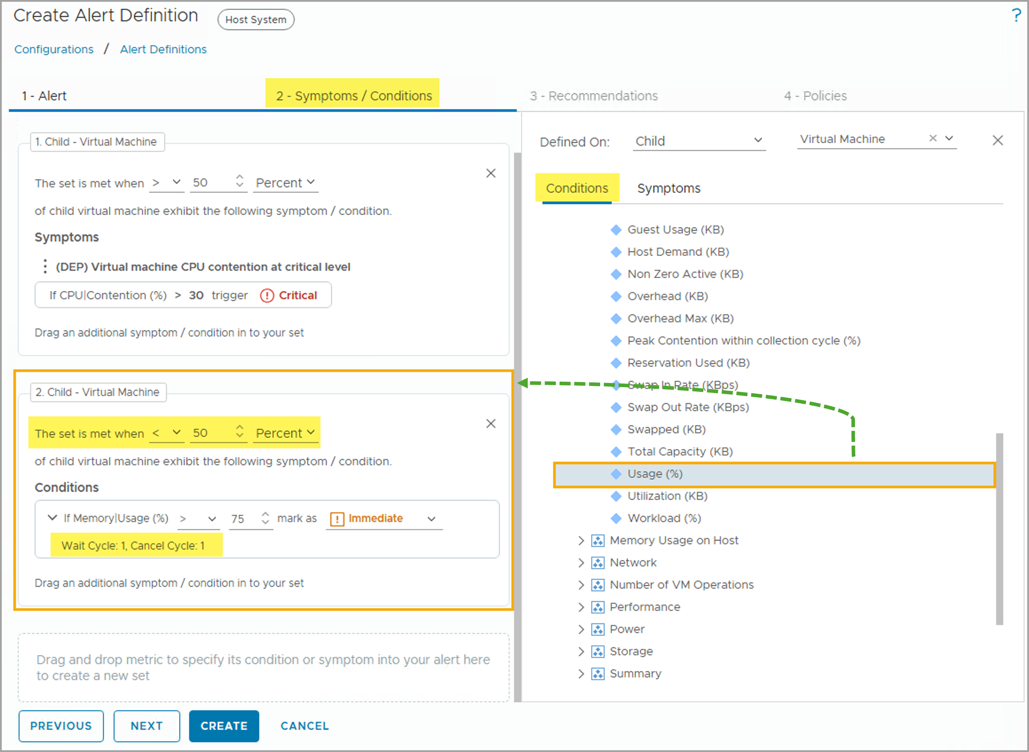
Adding Conditions to an Alert Definition
You can combine conditions and symptoms in an alert definition.
To add a condition to the alert definition, click the Condition tab and drag any condition you need to the Alert Definition area.
Conditions support static thresholds only and do not have advanced customization options (such as wait, cancel cycle, and instanced metrics). All conditions have a default wait cycle of 1 and a default cancel cycle of 1.
You must configure the test condition, static threshold, and the criticality of the added condition.
When any or all of the conditions and symptom tests are met, the alert is generated.
Notes:
TalkTrack:
Alert definitions allow for the combination of symptoms and conditions. To add a condition, drag it from the condition list to the alert definition area. Conditions are configured to use static thresholds exclusively and do not support advanced customization options such as wait cycles, cancel cycles, or instanced metrics. They default to a one-cycle wait and one-cycle cancel period. The alert is generated when any or all of the configured conditions and symptom tests are satisfied. When configuring a condition, several aspects require attention: the condition itself, which dictates how the specified value is compared to the current metric or property value; the threshold value that defines the trigger point; and the criticality, which sets the severity of the symptom when it is triggered. Additionally, the trigger condition must remain true for a specified number of collection cycles to activate the symptom. The default is one cycle, meaning the symptom triggers if the condition is true in the same collection cycle. Condition sets can incorporate various object types, such as virtual machines and host objects. Selecting an option from the drop-down menu for the condition set allows for specifying that all or only one test criterion must be met before the alert triggers.
<End>
The condition sets comprise an of expression that is evaluated to determine if an alert must be triggered:
Condition: Determines how the value that you specify in the value text box is compared to the current value of the metric or property when the condition is evaluated.
Value: Value that specifies the threshold.
Criticality level: Severity of the symptom or condition when the alert is triggered.
Wait Cycle: The trigger condition must be true for the number of collection cycles before the symptom or condition is triggered. The default value is 1. It means that the symptom or condition is triggered in the same collection cycle when the condition is true.
The condition set can contain different object types. In this example, a virtual machine and a host object type are selected. In the drop-down menu at the top of the condition set, you can specify that all or one test criteria must be met before the alert is triggered.

Slide 48
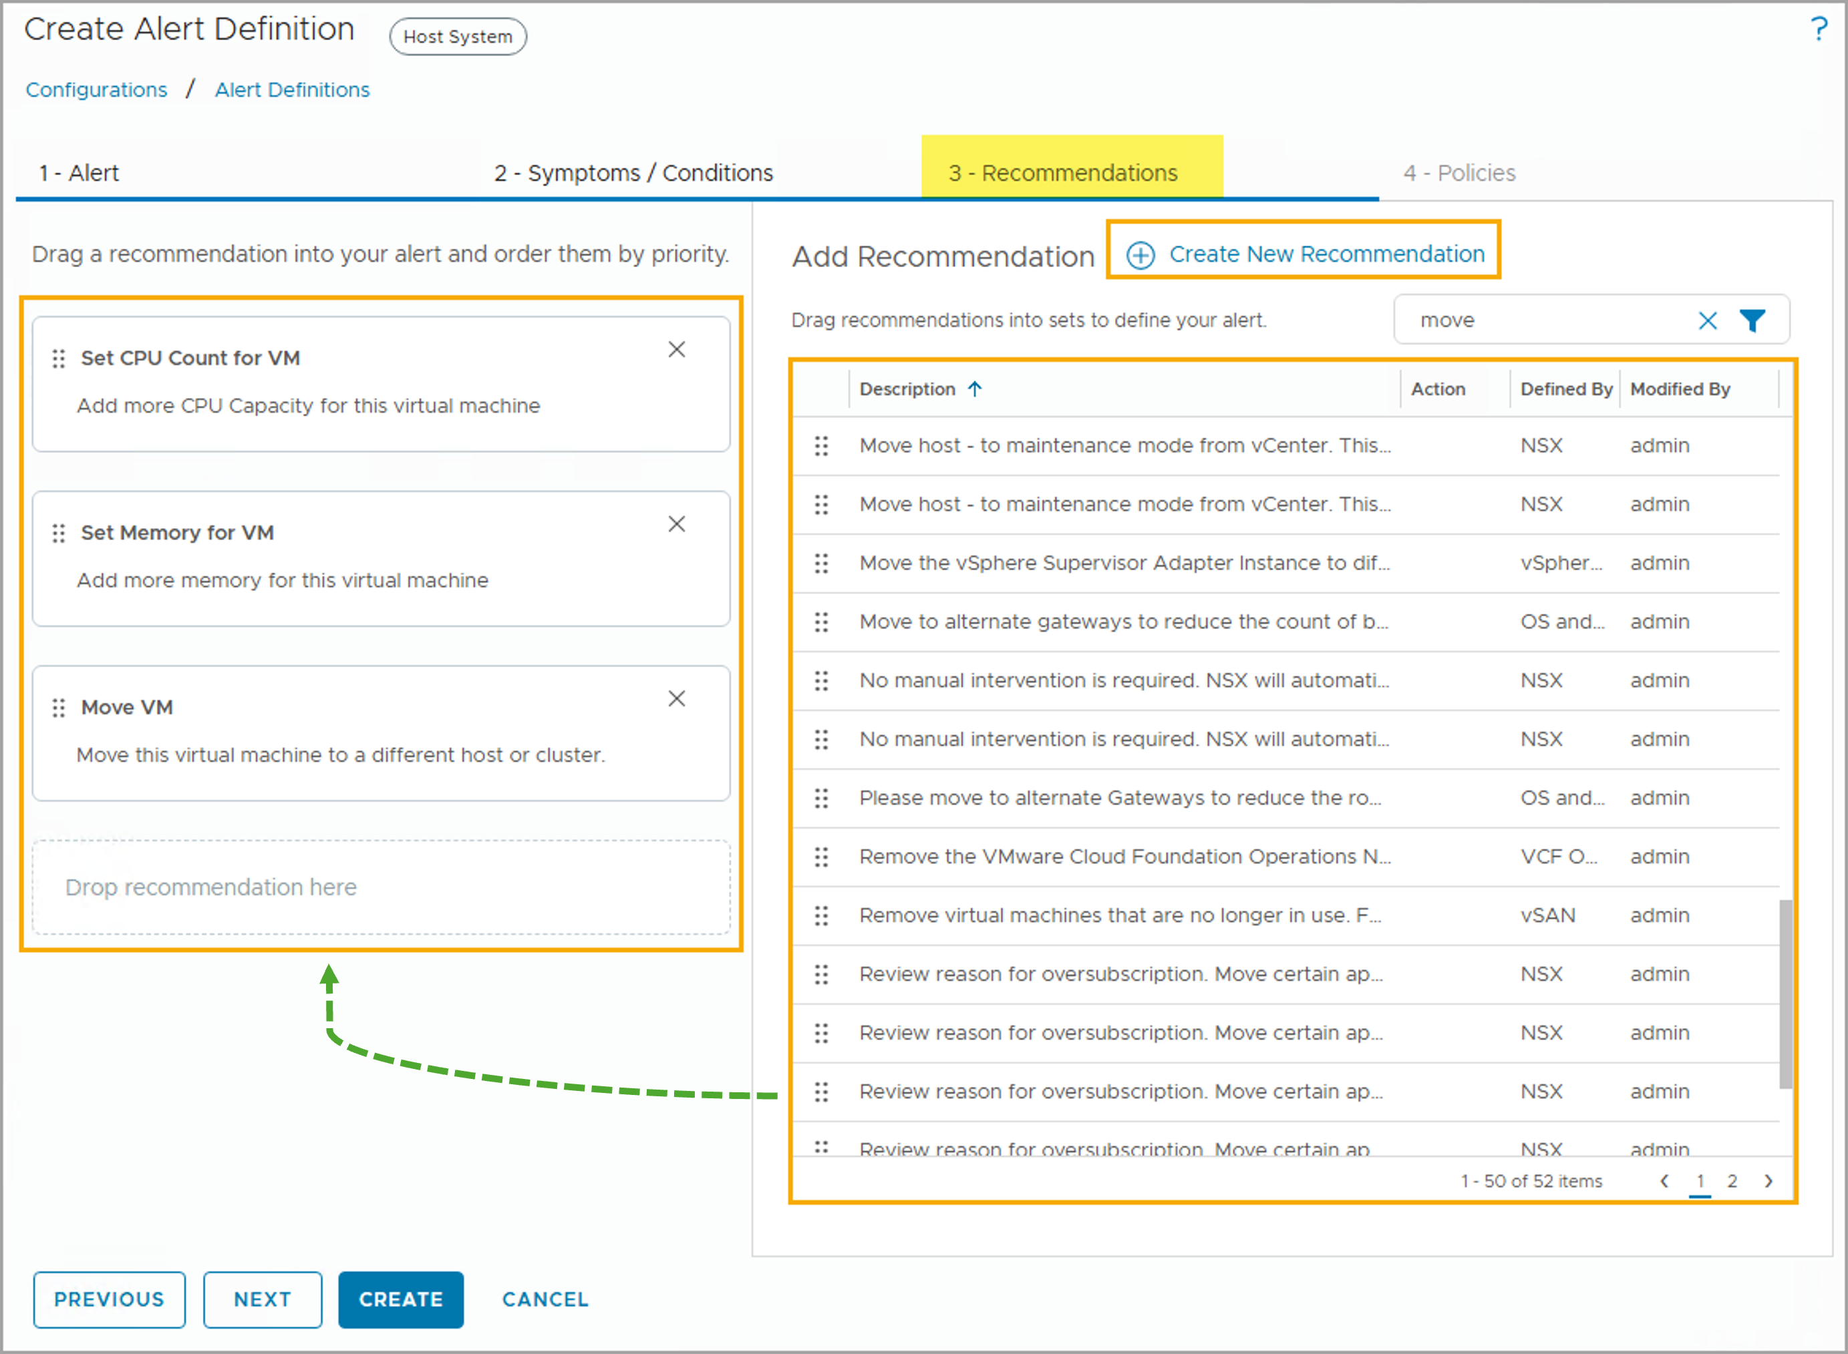
Adding Recommendations to an Alert Definition
Assigning recommendations to an alert definition enables you to provide useful troubleshooting information or resources to alert viewers. Adding recommendations is optional. You can assign zero or more recommendations to the alert definition.
If you add more than one recommendation, you can prioritize the recommendations.
If none of the existing recommendations fits your use case, you can also click + Create New Recommendations to create custom recommendations.
Notes:
TalkTrack:
Adding recommendations to an alert definition is an important step to provide helpful troubleshooting information to alert viewers. While optional, recommendations can significantly aid in problem resolution. If multiple recommendations are added, they can be prioritized by moving them up or down in the list. The system includes existing recommendations. If none of these are suitable for a particular use case, new ad hoc recommendations can be created by clicking "Create New Recommendation". A recommendation can be user-defined text, and it can also include HTML links to external resources like knowledge base articles. To view all recommendations, navigate to Infrastructure Operations, then Configurations, and then Recommendations in the VCF Operations console. The recommendation list displays all predefined and custom-built recommendations. To add a new custom recommendation, click the "Add" button. A recommendation can also include an action, which provides a single-click, automated way to fix the problem. Actions are associated with recommendations and are optional. They can be built-in or from installed solutions. The recommendation text box allows for detailed descriptions, including hyperlinks. For instance, a hyperlink to VMware documentation or a local wiki page can be provided. In the example, a plain text string describes modifying the CPU limit for a virtual machine. Actions can be added to recommendations through the "Create New Recommendation" dialog box. Update actions modify data or objects in monitored systems, while read actions retrieve data.
<End>
You drag zero or more recommendations to the Recommendations section. If multiple recommendations are provided, you can prioritize the recommendations by moving them up or down in the list. In the example, two recommendations are provided. You can also create a recommendation by clicking Create New Recommendation.

Slide 49
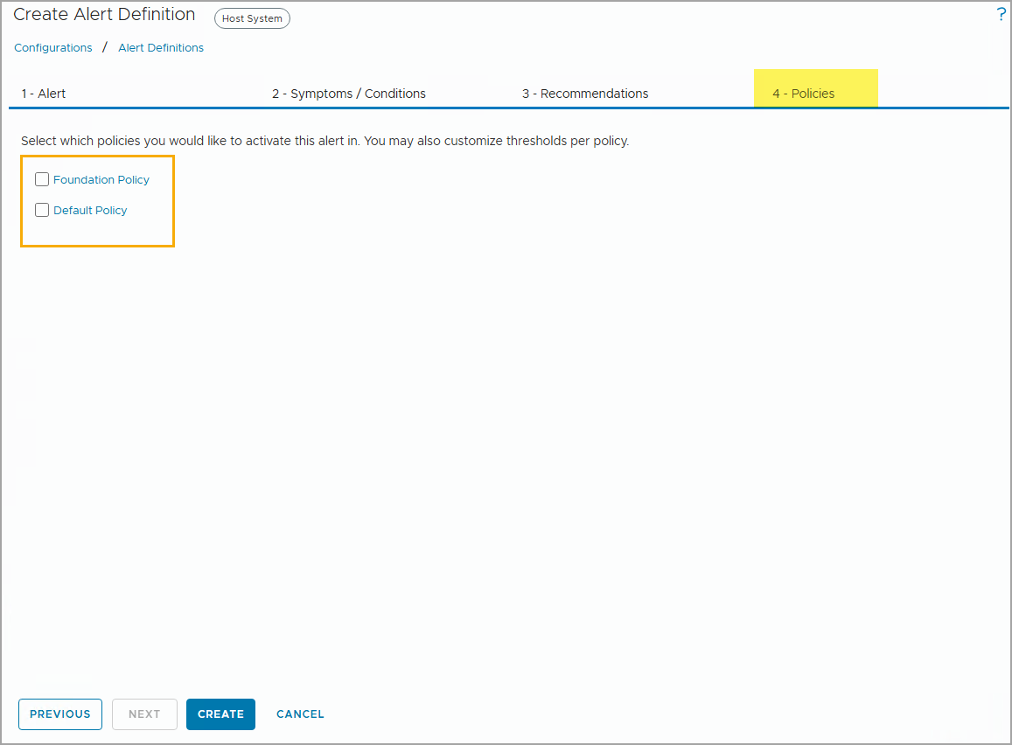
Assigning the Alert Definition to a Policy
You can select the policies in which you want to activate this alert. To associate this alert definition to any policy, select the checkbox beside the policy.
Assigning the alert definition to a policy is optional at the alert definition creation phase.
You can select multiple policies.
Notes:
TalkTrack:
Policies are assigned to alert definitions to determine their behavior. This assignment is optional during the alert definition creation process. To activate an alert definition, select the checkbox next to the desired policy. Multiple policies can be selected. Policies include various settings that dictate how information about objects is collected, displayed, and analyzed. They allow for the inheritance of settings from other policies and can be customized to support different service level agreements and business priorities. Key settings within a policy include metrics or properties for object types, symptom and alert definitions, and threshold definitions for factors like workload, time remaining, and capacity remaining. By selecting a policy, a user can also customize threshold settings on a per-policy basis.
<End>

Slide 50
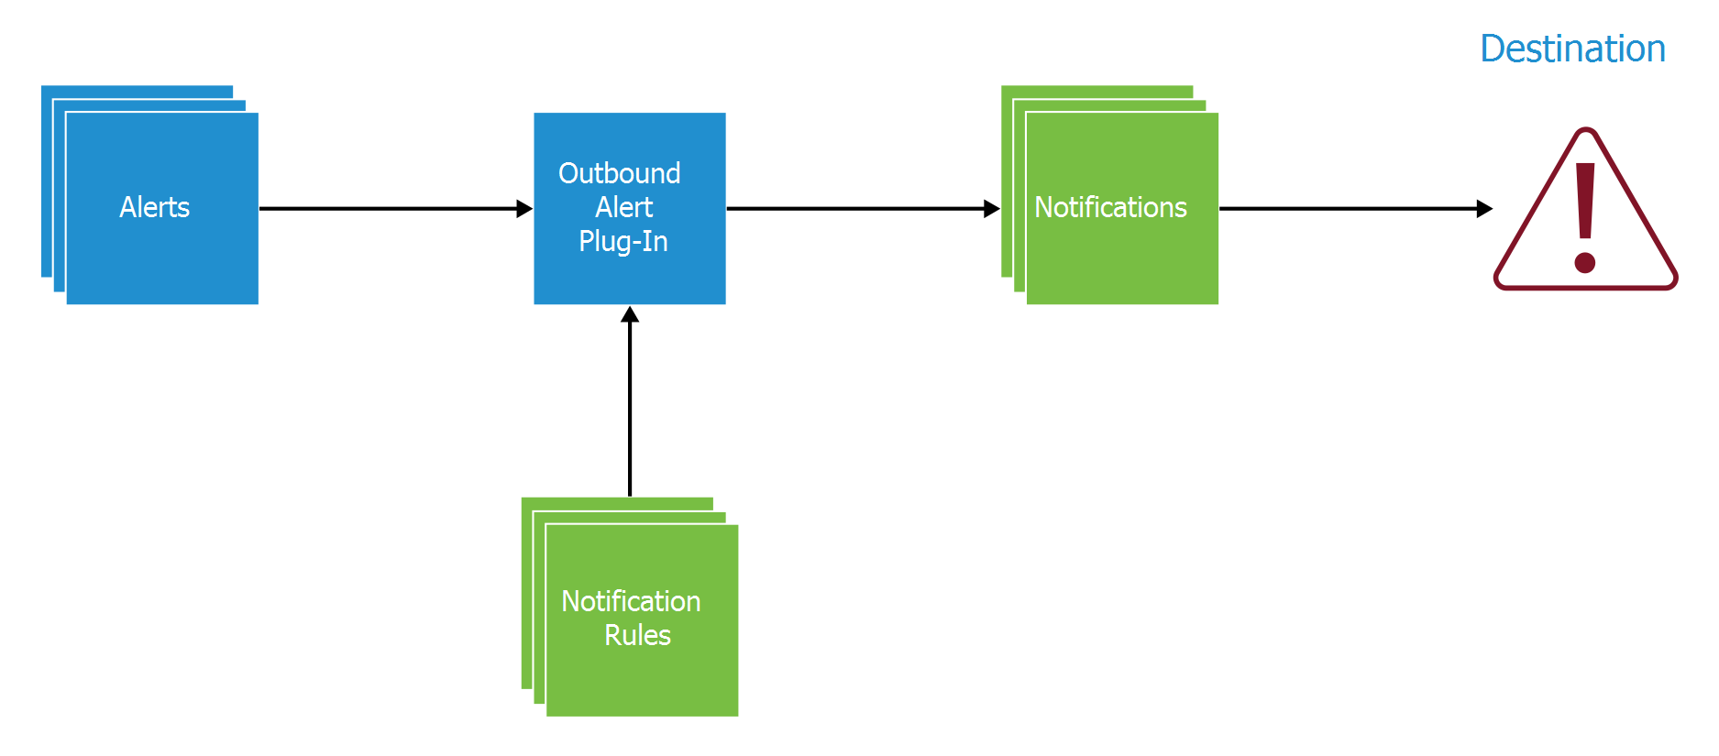
Sending Alert Notifications
VCF Operations can send alert notifications to emails and external destination monitoring systems with the help of outbound alert plug-ins.
Notes:
TalkTrack:
VCF Operations can send alerts to various destinations, including emails and external monitoring systems. This capability relies on outbound alert plug-ins. When an alert is generated, it is passed to an outbound alert plug-in. This plug-in, based on its configuration, then sends the notification to the designated external system. Notification rules play a crucial role in managing these communications. They allow for filtering unnecessary alerts, ensuring that only relevant information reaches the destination. These rules are particularly useful when using plug-in types such as Standard Email, SNMP, or REST Notification.
<End>
The outbound alert plug-in instance receives the alert. The communication settings that are configured for the plug-in are used to communicate and send the alert information to the destination system. If the outbound alert plug-in type is Standard Email, SNMP, or REST Notification, notification rules can be created to filter unnecessary alerts.

Slide 51
Outbound Alert Plug-in Types
To send alert notifications externally, you need to configure one or more outbound alert plug-ins. VCF Operations supports several types of outbound alert plug-ins.
Alert Plug-in | Use Case
Standard Email | Email alert notifications to any interested individuals, for example, storage administrators or network operations engineers
SNMP Trap | Logs alerts on an SNMP trap server in your environment
Webhook Notification | Sends outbound payload to any endpoint REST API
Log File | Logs alerts to a file on a VCF Operations instance
Network Share | Sends reports to a shared location
Service-Now Notification | Creates a Service Now incident when an alert is triggered
Slack | Forwards alerts to different Slack channels
Notes:
TalkTrack:
VCF Operations leverages outbound alert plug-ins to send notifications to external systems. Different plug-in types are available for various notification needs: The Standard Email plug-in is used for sending alert notifications directly to email addresses, useful for administrators or operations engineers. For integrating with network monitoring, the SNMP Trap plug-in dispatches logs as SNMP traps to a trap server. Webhook Notification enables sending data payloads to any REST API endpoint. The Log File plug-in records all alerts to a log file on the VCF Operations instance itself. Network Share allows reports to be sent to a shared location, though it has specific version requirements. For service management, the Service-Now Notification plug-in can create an incident in Service-Now whenever an alert is triggered. Finally, the Slack plug-in facilitates forwarding alerts to different Slack channels, supporting pre-formatted details and VCF Operations links for further troubleshooting. Any plug-in that comes as part of a management pack can also be configured as an outbound notification option.
<End>
To send alert notifications to an external system, configure one or more of the following outbound alert plug-ins:
Standard Email: Allows you to use SMTP to email alert notifications to interested individuals.
SNMP Trap: Allows you to send alerts as SNMP traps to an external system. Alerts must be filtered on the destination SNMP trap server.
Webhook Notification: You can integrate Webhook with any endpoint REST API and configure outbound payload.
Log File: Allows you to send all the alerts to a log file on the VCF Operations node. If you installed VCF Operations as a multiple node cluster, each node processes and logs the alerts for the objects that it monitors.
Network Share: Used to configure VCF Operations Manager to send reports to a shared location. The Network Share plug-in supports only SMB version 2.0. SMB version 1.0 is not supported.
Service-Now Notification: You add a Service-Now Notification plug-in when you want to integrate the Service Now ticketing system with VCF Operations Manager. Service Now creates an incident whenever an alert is triggered in VCF Operations.
Slack: You can add a Slack plug-in to forward alerts and configure multiple notification rules with different Slack channels. The Slack plug-in allows you to receive pre-formatted alert details with alert fields and helps you run VCF Operations using alert links to troubleshoot further.
Any plug-in included in a management pack that you install will then appear in VCF Operations as an another plug-in option.

Slide 52
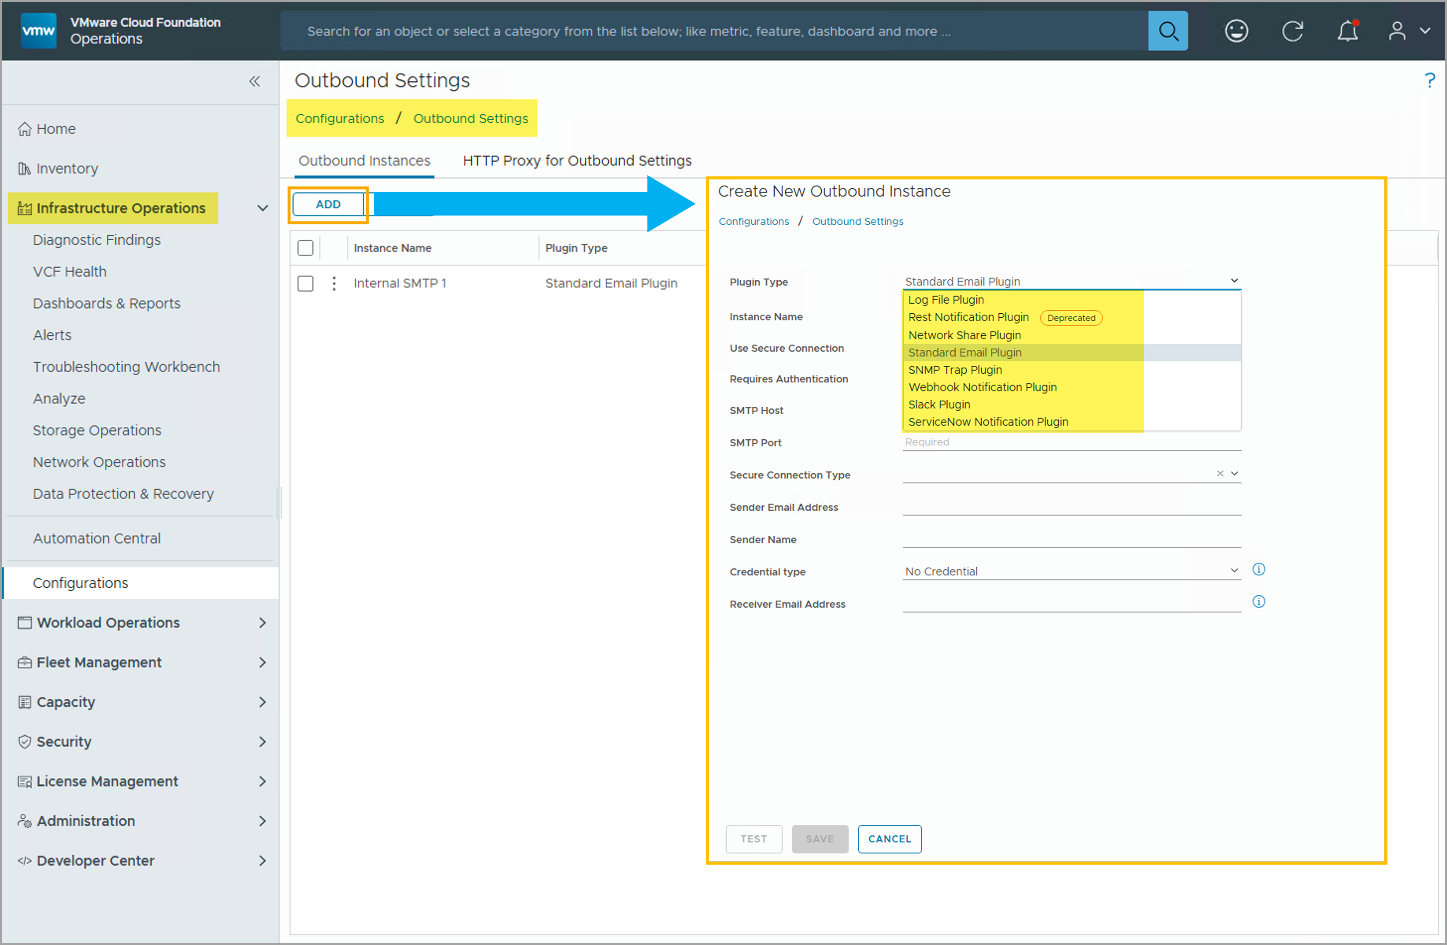
Creating Outbound Alert Plug-In Instances
Outbound Settings is used to manage your communication settings so that you can send information to users or applications external to VCF Operations.
To access the outbound alert plug-in settings, navigate to Infrastructure Operations > Configurations > Outbound Settings.
To add a new outbound instance, click ADD and complete the following tasks:
Select the plug-in type.
Provide a plug-in instance name.
Configure the settings specific to the outbound instance selected, such as host name, port number, SSL/TLS type, authentication, domain, file share path, and so on.
A plug-in instance is automatically enabled after it is created.
Notes:
TalkTrack:
Outbound settings provide the means to manage communication with external users or applications from VCF Operations. To access these settings, navigate to Infrastructure Operations, then Configurations, and then Outbound Settings. To add a new outbound instance, click "Add" and follow a few steps: First, select the specific plug-in type that will be used for notifications. Next, provide a descriptive name for the plug-in instance. Finally, configure the settings unique to the chosen plug-in instance. This may include details such as hostname, port numbers, security types, authentication credentials, domain information, or file paths. Once created, a plug-in instance is automatically enabled. It is possible to create multiple instances for each outbound plug-in type. For example, multiple plug-in instances can be set up to send email notifications to different destinations. For outbound communication using HTTP and HTTPS protocols, an HTTP proxy can be configured in VCF Operations. After setting up the proxy, all corresponding outbound communication flows through it. Additionally, alerts from the VCF Operations adapter are forwarded to the log file.
<End>
You can create multiple instances, one for each outbound alert plug-in that you want to use. For example, to send alert notifications to more than one email server, you create a plug-in instance for each email destination. All alerts from the VCF operations adapter are forwarded to the log file. You can configure an HTTP proxy for outbound communication over HTTP and HTTPS protocols in VCF Operations. After you configure the HTTP proxy for an outbound setting, all the corresponding outbound HTTP(S) communication occurs through that proxy.

Slide 53
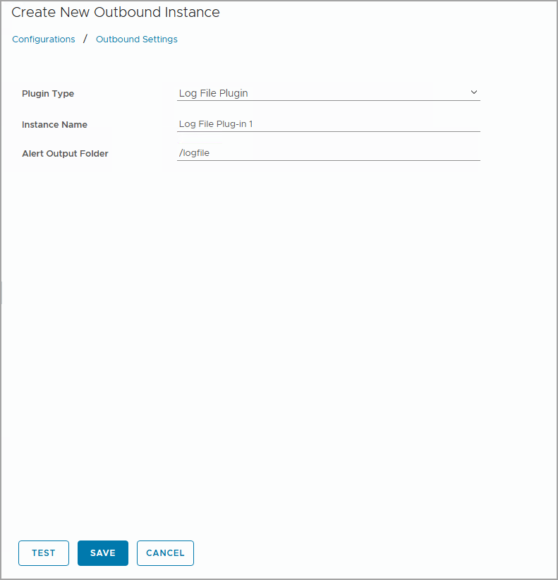
Configuring the Log File Plug-Ins
The log file plug-in has a simple configuration. You configure an instance name and the name of an existing directory on the VCF Operations node.
To configure the log file plug-in, you specify the output folder on the VCF Operations node.
All alerts from the VCF Operations adapter are forwarded to the log file. No rules are required.
Notes:
TalkTrack:
The Log File plug-in offers a straightforward way to configure alert notifications. To set it up, one must specify an instance name and provide the path to an existing directory on the VCF Operations node where alert logs will be stored. All alerts from the VCF Operations adapter are automatically forwarded to this designated log file, and no additional rules are needed for its operation. For example, the output folder could be specified as /logfile. A "Test" button is available to verify that the specified directory is accessible. If the directory does not exist on the VCF Operations node, the test will indicate a failure.
<End>
In the example, the name of the directory is /logfile. By clicking TEST, you verify that the directory is accessible. If the directory does not exist on the VCF Operations node, the test is unsuccessful.

Slide 54
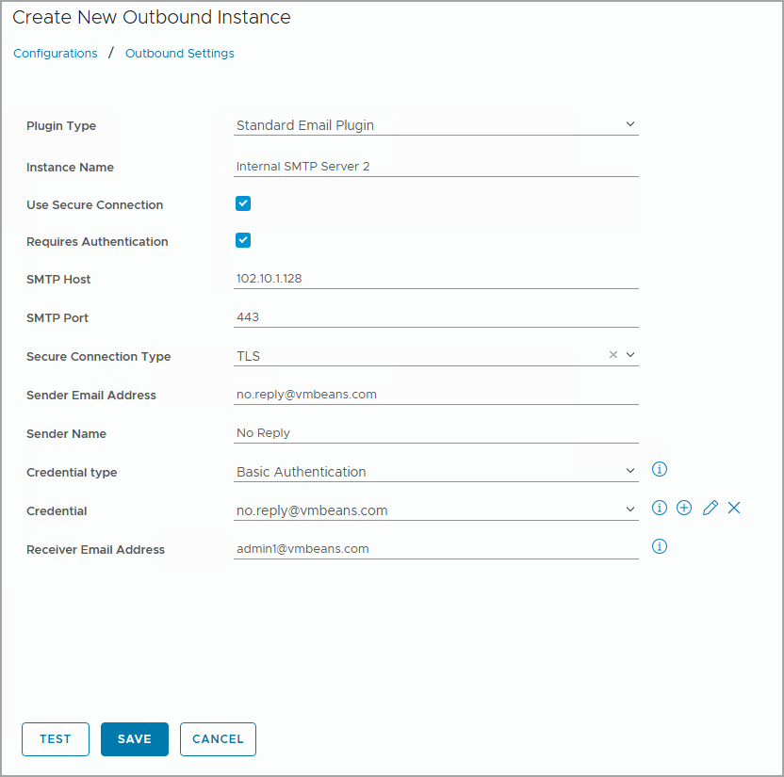
Configuring the Standard Email Plug-Ins
With a Standard Email Plug-In, you enable the VCF Operations environment to send alert emails to the designated recipients, such as infrastructure administrators or support desk email lists.
To configure the Standard Email Plug-In, you must gather the following configuration information:
SMTP host and port
Secure connection type
Authentication details
Sender email and name
You can use a secure connection and require authentication for the Standard Email Plug-In.
Notes:
TalkTrack:
To enable VCF Operations to send alert emails to specified recipients, such as infrastructure administrators or support desk personnel, the Standard Email Plug-in needs to be configured. Successful configuration requires gathering several pieces of information: The SMTP host and port are essential for connecting to the email server. The default SMTP port is 25. A secure connection type can be enabled, using either SSL or TLS as the encryption method. Authentication details are necessary if the email server requires a user account to connect. This includes a user name and password. The sender's email address, which appears on the notification message, and the sender's displayed name must be provided. Finally, a receiver email address is needed for connection testing purposes. The "Test" button allows for verification of the connection and configuration.
<End>
You configure the following SMTP settings for the Standard Email Plug-In:
Use Secure Connection: Enables secure communication encryption using TLS or SSL. If you select this option, you must select a method in the Secure Connection Type drop-down menu.
Requires Authentication: Enables authentication on the email user account that you use to configure this SMTP instance. If you select this setting, you must provide a password for the user account.
SMTP Host: URL or IP address of your email host server.
SMTP Port: Default port that SMTP uses to connect with the server.
Secure Connection Type: Select either SSL or TLS as the communication encryption method.
User Name: Email user account to connect to the email server.
Password: Password for the connection user account.
Sender Email Address: Email address that appears on the notification message.
Sender Name: Displayed name for the sender email address.
Receiver Email Address: An email address that is used for connection test only.

Slide 55
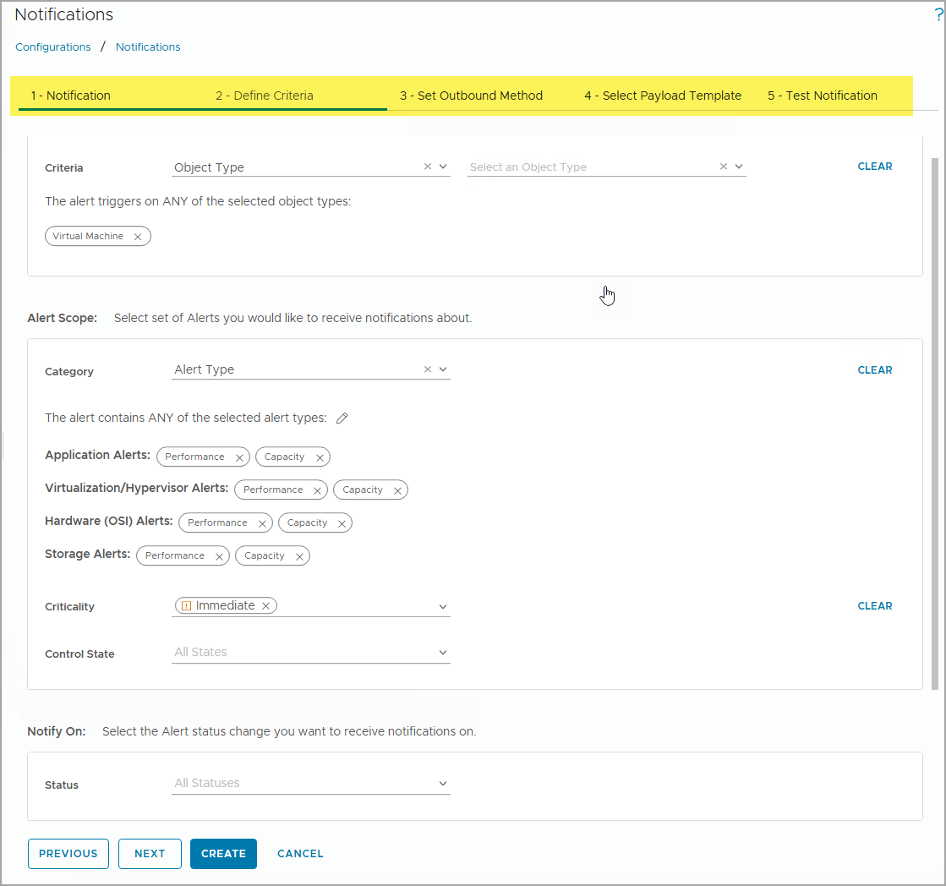
Creating Notification Rules
Notification rules control how different types of alert notifications are sent to which recipients by what outbound methods.
After creating the alert definitions and adding the outbound alert plug-in instances, you must configure notification rules so that alert notifications can be sent externally.
To create a notification rule, navigate to Infrastructure Operations > Configurations > Notifications, click ADD, and complete the necessary notification rule settings.
Notes:
TalkTrack:
Notification rules govern how various types of alert notifications are delivered to designated recipients through specific outbound methods. After setting up alert definitions and outbound alert plug-in instances, these rules are crucial for external alert delivery. To create a new notification rule, navigate to Infrastructure Operations, then Configurations, and then Notifications, and click "Add". The process involves completing several tasks: First, configure the general notification rule settings, including a name and description. Next, define the criteria for the notification. This includes selecting the object type for which the alert triggers, defining the alert scope (whether to receive notifications about any or specific selected object types), and specifying the alert categories. Alert categories encompass types such as Application, Virtualization/Hypervisor, Hardware, Storage, Network, Administrative, and Findings. Further refinement can be done by selecting criticality levels like Immediate, Warning, Critical, Info, or Symptom Based. Control state and the specific alert status changes that warrant notifications can also be set. After defining the criteria, select the outbound method that will be used for delivery. This involves choosing a configured outbound plug-in instance. Then, select the payload template and configure the notification delivery information, which includes specifying the recipients and the schedule for notifications. Finally, there is an optional step to test the notification delivery with the configured settings, ensuring that alerts are sent as expected.
<End>
To create a notification rule, you need to complete the following tasks:
Configure general notification rule settings, such as name and description.
Configure notification criteria, including object type, alert scope, notification criteria, notification heartbeat.
Select the outbound methods.
Configure payload template and notification delivery information, including recipient and notification schedule.
(Optional) Test the notification delivery with the specified configurations.

Slide 56
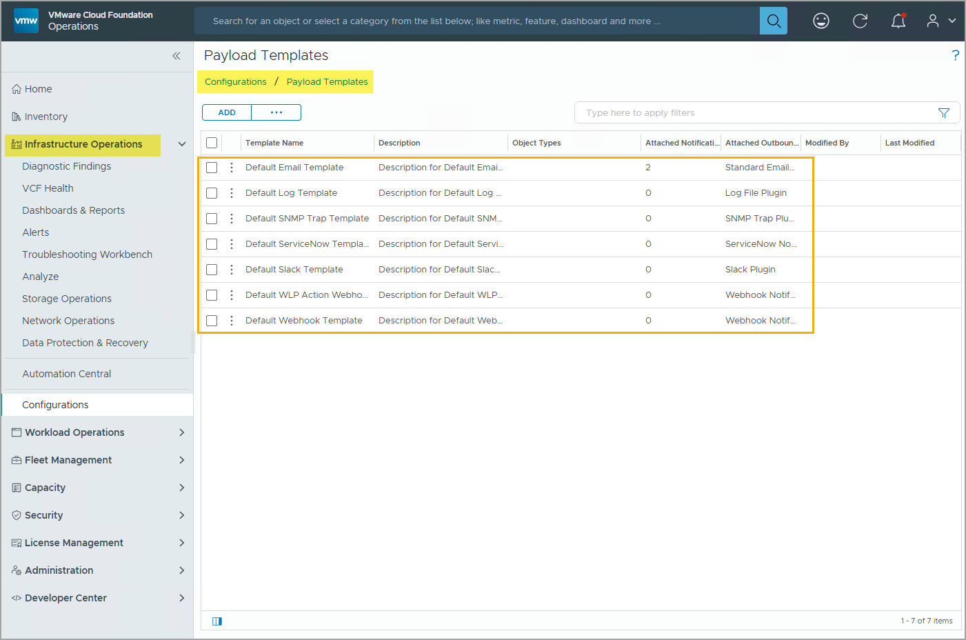
Understanding Payload Templates
Payload templates are alert notification message templates that are used when sending an alert notification.
VCF Operations provides a set of default payload templates for various outbound methods, including Email, Log, SNMP Trap, ServiceNow, Slack, WLP Action, and Webhook.
To view existing payload templates and to add new custom payload templates, navigate to Infrastructure Operations > Configurations > Payload Templates.
You can also create a customized payload template for alert notifications to meet your needs.
Notes:
TalkTrack:
Payload templates define the structure and content of notification messages sent when an alert is triggered. VCF Operations includes a set of default payload templates that are designed for various outbound communication methods, such as email, SNMP traps, ServiceNow, Slack, WLP actions, and webhooks. It is also possible to create customized payload templates to meet specific notification requirements. To view existing templates or add new custom ones, navigate to Infrastructure Operations, then Configurations, and then Payload Templates. Customization options include providing Rich Text support for HTML email notifications. These templates can also incorporate parameters for various alert properties, including object type, object metrics, and information about parent and ancestor objects. Furthermore, different payload details can be configured for new, updated, and canceled alerts, ensuring relevant information is always provided based on the alert's lifecycle.
<End>
You can customize a payload template for alert notifications to meet your needs:
Provides a Rich Text editor for HTML email support
Supports parameters for alert properties, selecting object type, object metrics, parents, and ancestors
Provides different payload details for new, updated, and cancelled alerts

Slide 57
Review of Learner Objectives
Configure a custom alert using the Create Alert Definition workflow
Add symptoms, conditions, and recommendations to an alert definition
Create notifications for a custom alert definition

Slide 58
Managing Alerts

Slide 59
Learner Objectives
Examine and manage triggered alerts

Slide 60
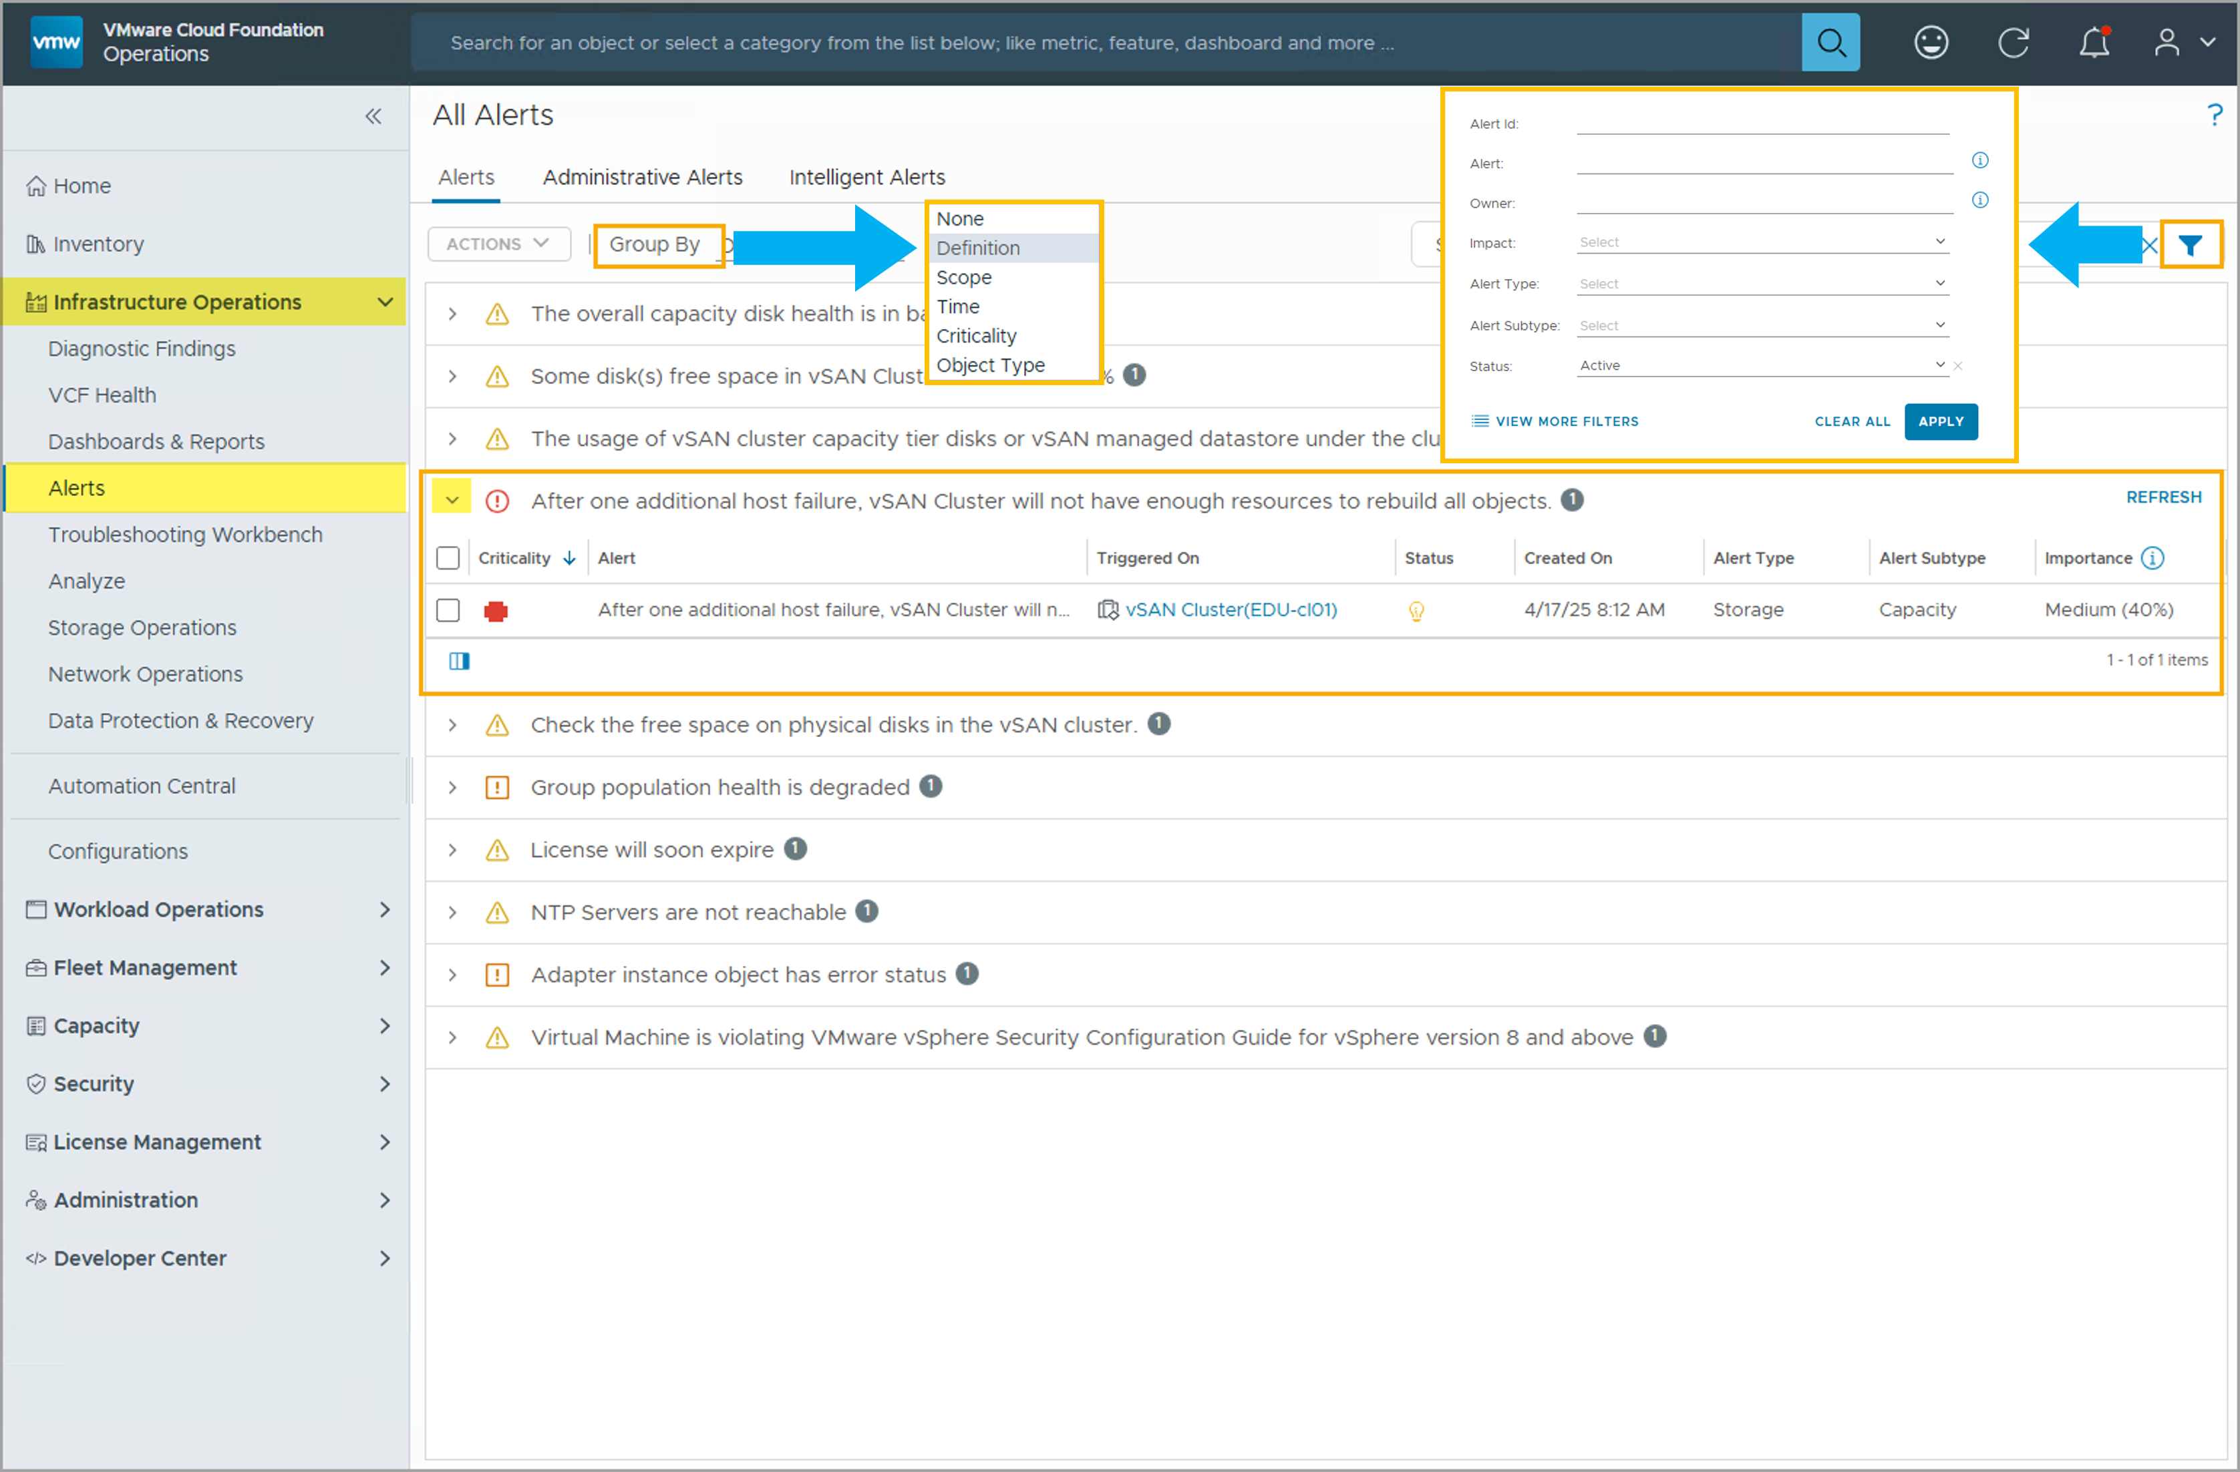
Viewing Alerts in VCF Operations
All alerts generated in the environment are grouped and listed on the Alerts page in the VCF Operations console. To view the Alerts page, navigate to Infrastructure Operations > Alerts.
The Alerts page provides the following options to help you group and locate alerts:
Group By: You can change how alerts are grouped and displayed based on criteria such as Criticality, Definition, Object Type, and so on.
Filter: You can use filter options to only view alerts that match certain criteria such as owner, alert types, impact, and so on.
To view the generated alerts, click the Expand button next to each alert group.
Notes:
TalkTrack:
All alerts generated within the environment are displayed on the Alerts page in the VCF Operations console. To access this view, navigate to Infrastructure Operations, and then select Alerts. The Alerts page provides several options to help organize and locate specific alerts. Alerts can be grouped based on criteria such as criticality, the specific alert definition, or the object type. Filtering capabilities allow for viewing only those alerts that match certain criteria, including the alert's owner, its types, or its impact. To see the individual alerts within a group, click the "Expand" button next to the alert group. Alerts are generated when symptom definitions are triggered, which occurs when the metrics or properties of objects in the environment operate outside their predefined parameters. While alerts indicate that a problem exists, they do not provide an explanation of the root cause. However, it is possible to view the triggered alert, the specific object it pertains to, the time it was generated, and whether the alert is currently active or disabled. For instance, a critical virtual machine CPU demand alert is triggered when its percentage metric exceeds 95 percent.
<End>
Alerts are generated when the symptoms in an alert definition are triggered. The symptoms are triggered when the objects in your environment do not operate within the parameters specified. For example, a virtual machine CPU demand at the critical level symptom is triggered when the Virtual Machine: CPU|Demand (%) metric is greater than 95 percent.
You can view the alert triggered and the object on which it was triggered. You can also view the time that the alert was generated and whether the alert is active or disabled.

Slide 61
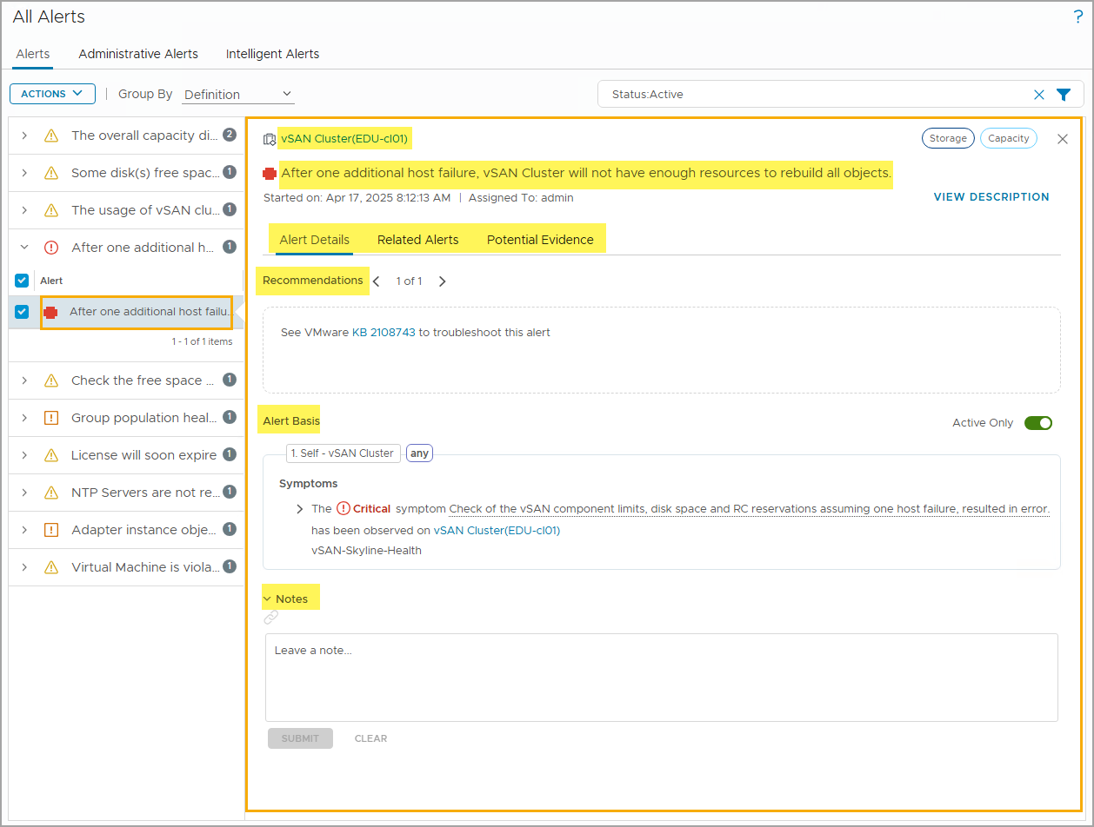
Examining Alert Details
On the Alerts page, you can click any alert to view the details of the selected alert.
On the alert details view, you can easily access the following information:
Object name
Alert definition triggered
Recommendations
Alert basis
Related alerts
Potential evidence
Notes
Notes:
TalkTrack:
From the Alerts page, selecting any alert provides a detailed view of its information. The alert details view provides several key pieces of information: The object name identifies the specific entity that is potentially experiencing a performance issue or a fault. The "Alert definition triggered" indicates the precise issue or fault that the object has encountered. "Recommendations" offers guidance to help gather potential resolutions for the alert. The "Alert basis" explains which symptoms were used to conclude that the alert should be triggered. "Related alerts" displays any other alerts that are linked to the currently selected alert. "Potential evidence" provides useful information to assist in identifying the problem and working towards its root cause. Finally, the "Notes" section allows for reviewing any comments or observations left by other users or the owner of the alert.
<End>
Object name: allows you to identify which object is potentially experiencing performance issue or having fault
Alert definition triggered: allows you to know what issue/fault the object had experienced
Recommendations: allows you to gather potential resolutions
Alert basis: allows you to identify what symptoms were used to conclude this alert
Related alerts: shows other generated alerts that are related to this selected alert
Potential evidence: shows potentially useful evidence to help you confirm the issue and work towards finding the root cause
Notes: allows you to see the notes left by other users/owners

Slide 62
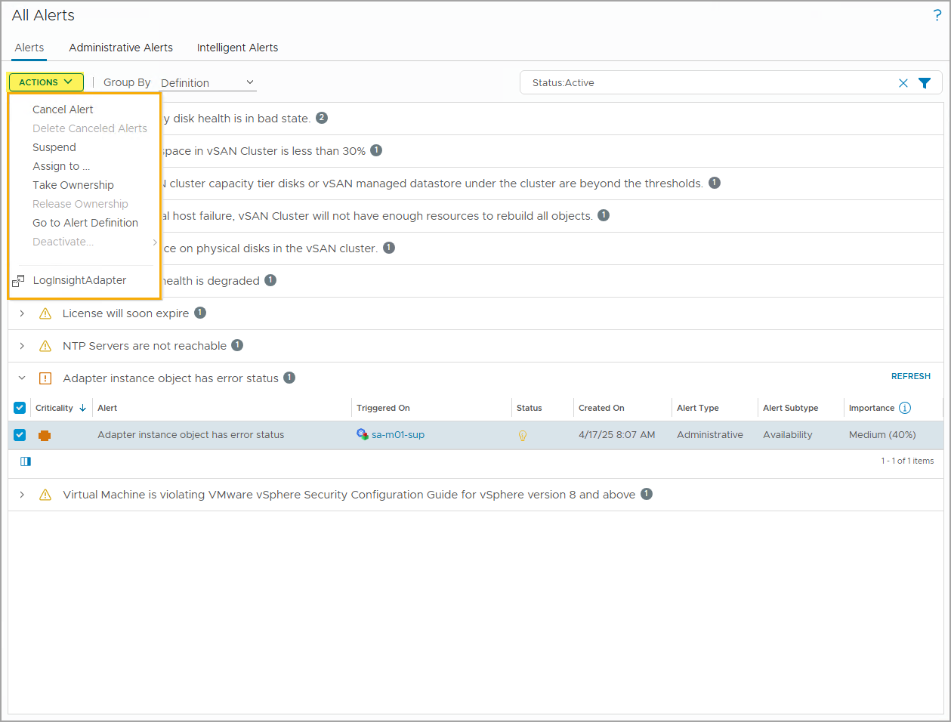
Taking Actions on an Alert
To view the available actions that you can take towards an alert, select an alert and click Actions.
You can use the following available actions to manage a selected alert:
Cancel Alert
Delete Canceled Alerts
Suspend
Assign to ...
Take Ownership
Release Ownership
Go to Alert Definition
Deactivate
LogInsightAdapter
Notes:
TalkTrack:
From the Alerts page, after selecting a specific alert, it is possible to view the available actions that can be taken. To reveal these options, click the "Actions" button. Several actions are available to manage a selected alert: The "Cancel Alert" option marks the alert as canceled. "Delete Canceled Alerts" permanently removes any alerts that have been previously canceled. "Suspend" temporarily halts the generation of alerts. "Assign To..." allows for delegating the alert to a specific user or group. "Take Ownership" enables the current user to assume responsibility for the alert. Conversely, "Release Ownership" relinquishes responsibility for the alert. "Go to Alert Definition" provides a direct navigation link to the underlying alert definition. "Deactivate" disables the alert definition itself. There is also a specific action for the LogInsightAdapter.
<End>

Slide 63
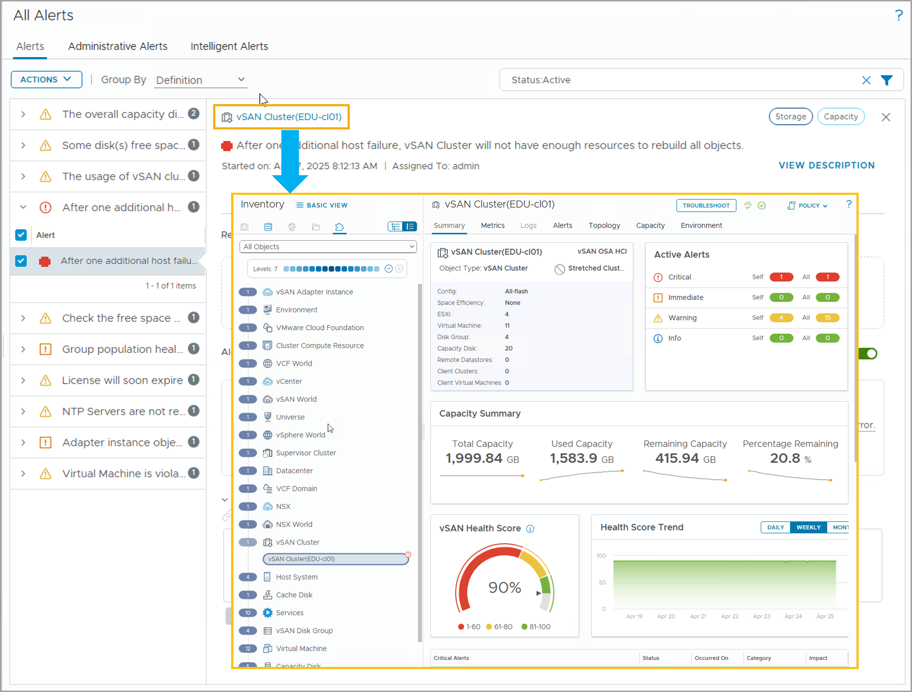
Accessing Object Details View from an Alert
From the alert details view, you can click the object name to access the object details view.
Notes:
TalkTrack:
From the alert details view, it is possible to directly access the comprehensive object details view by clicking on the object's name. This object details view provides a wealth of information across several tabs, including a Summary, Metrics, Alerts, Topology, Capacity, and Environment. Within this view, users can observe the object's current health score and its historical health trend, offering insights into its stability over time. It also presents key metrics such as a capacity summary, detailing the total, used, and remaining capacity, along with the percentage remaining. This helps in assessing resource utilization. The example provided illustrates details for a vSAN Cluster object.
<End>

Slide 64
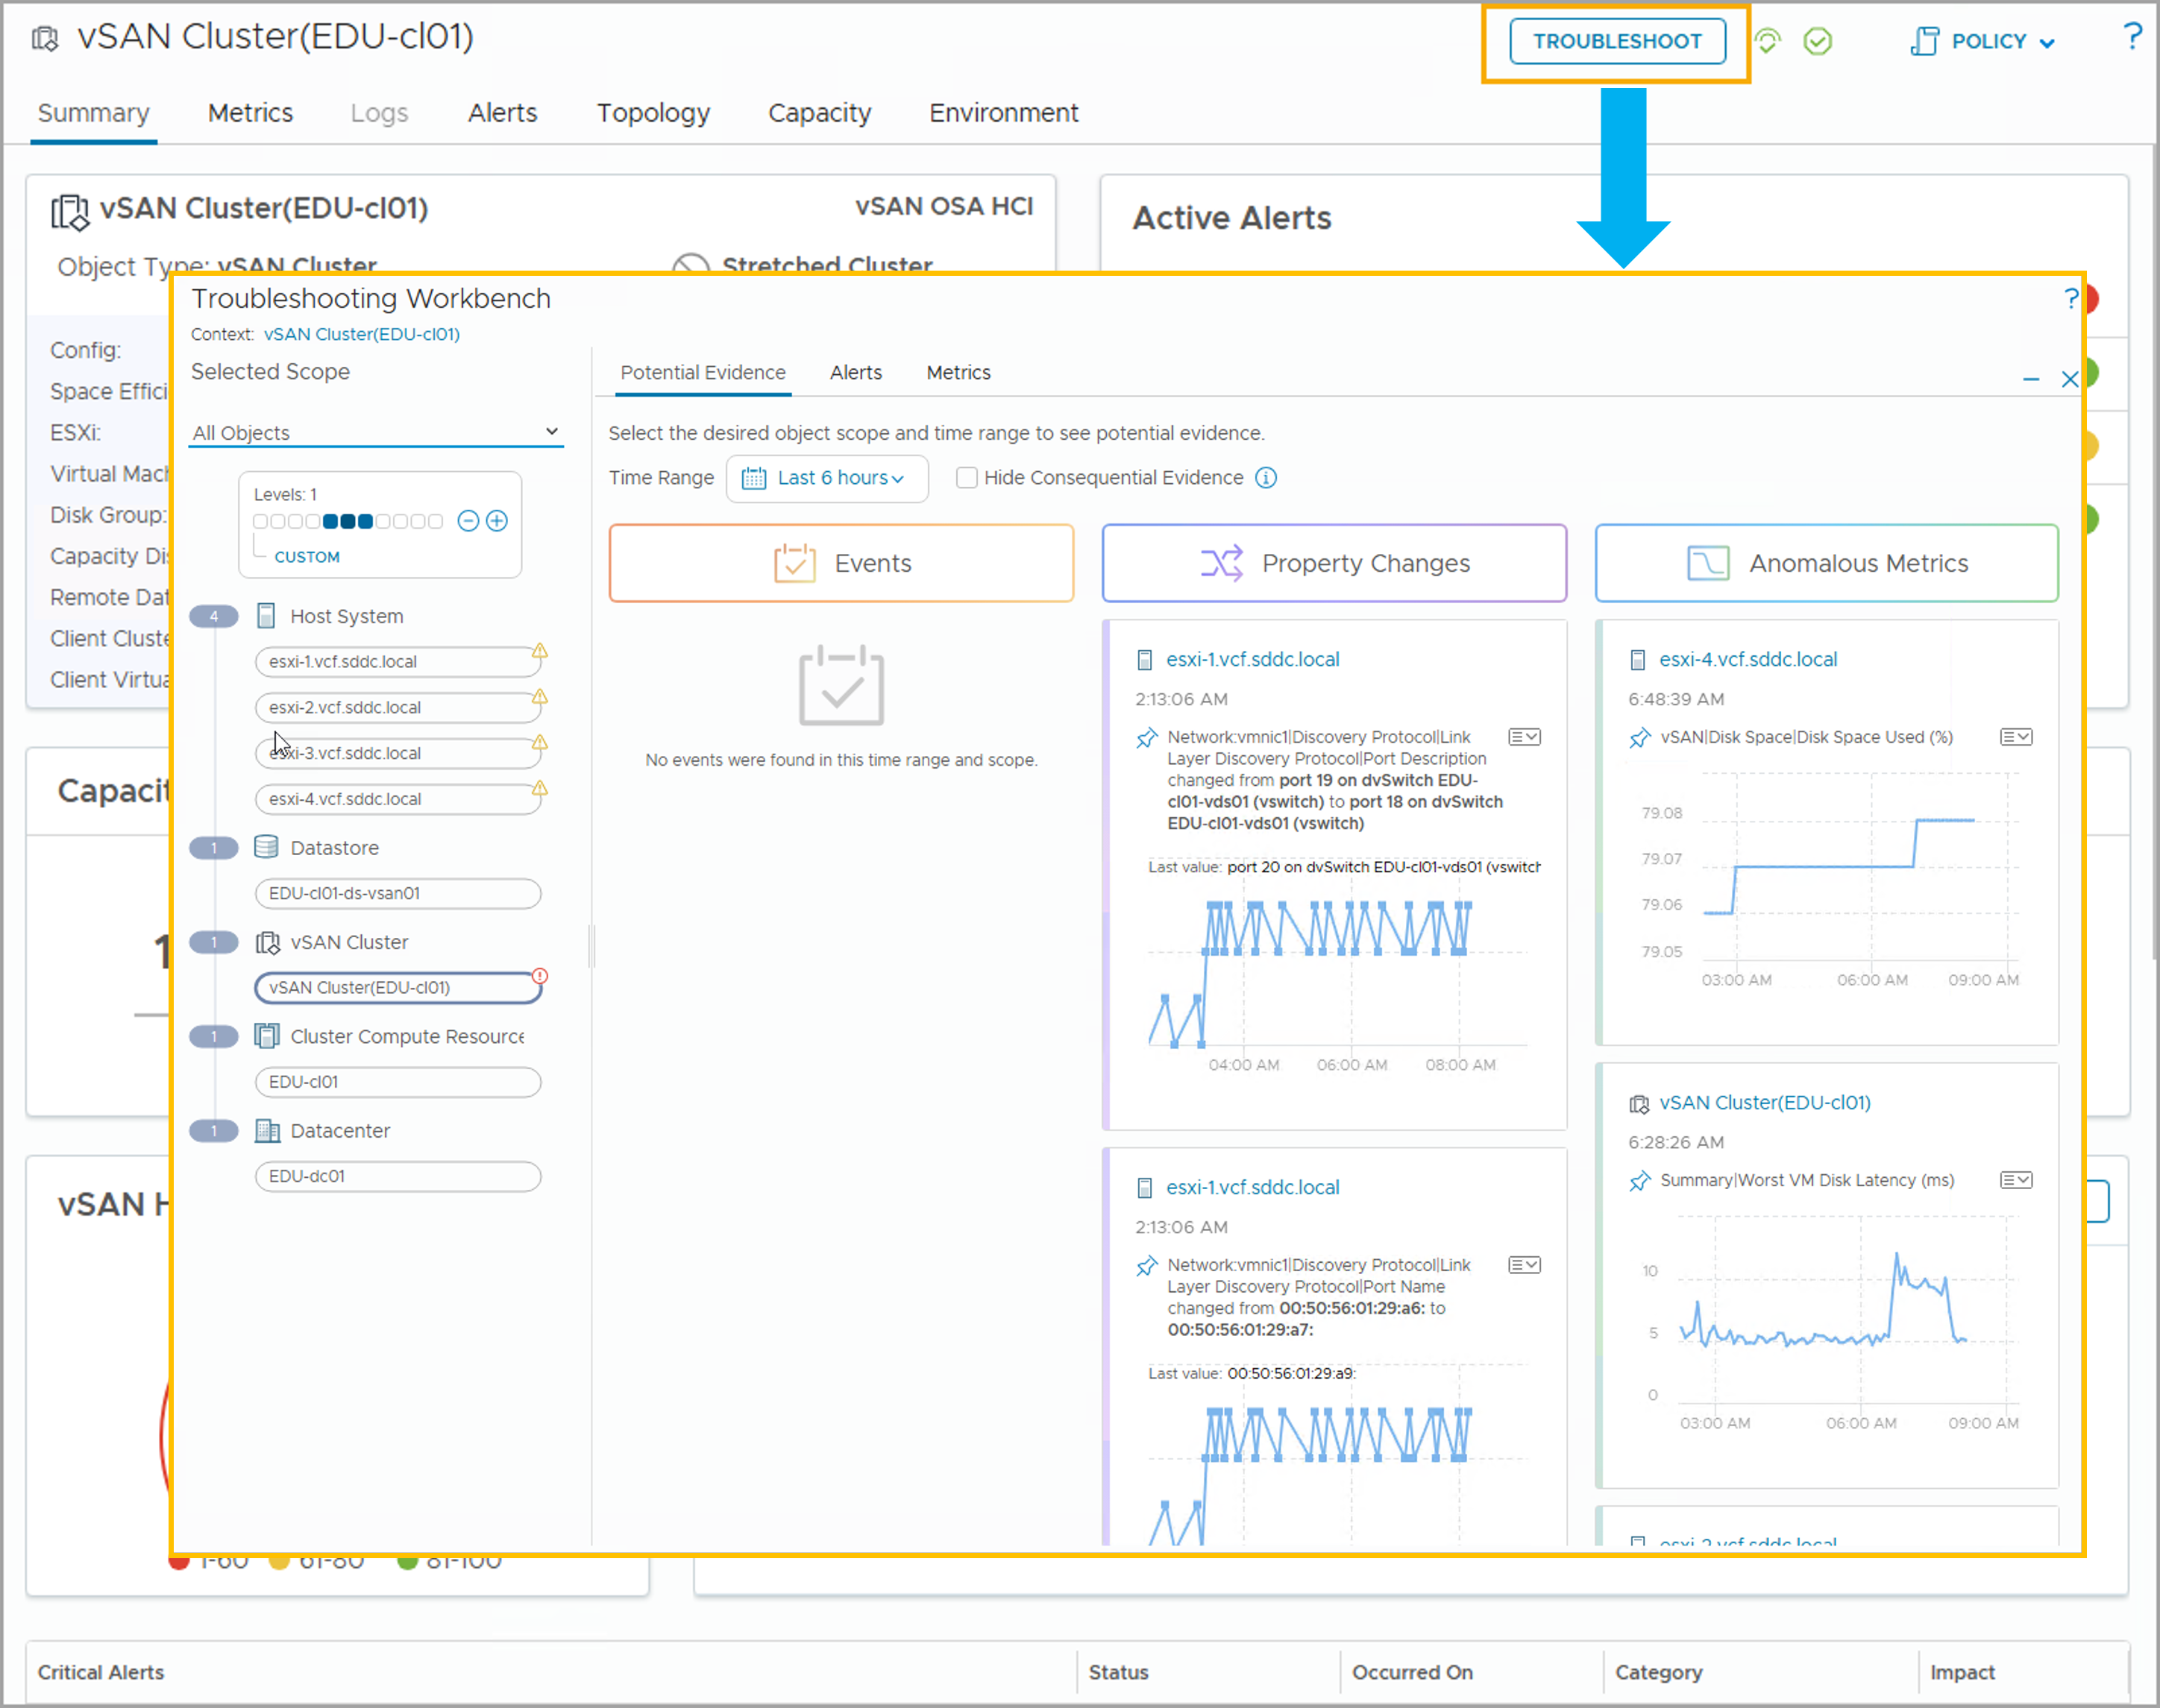
Accessing Troubleshooting Workbench for an Object
From the object details view, you can click TROUBLESHOOT to access the Active Troubleshooting session page for this object.
Notes:
TalkTrack:
From the object's details view, the "Troubleshoot" button provides a direct pathway to the active troubleshooting session page for that specific object. The Troubleshooting Workbench serves as a central hub, displaying both active troubleshooting sessions and recent searches. From an active session, users can access critical evidence to aid in resolving issues and conditions. Potential evidence is organized and presented for a specific scope and time, categorized into several forms:"Events" highlight metrics that have deviated from expected behavior. "Property Changes" identify significant configuration modifications that have occurred. "Anomalous Metrics" point out drastic changes in metrics, ranked by their degree of change to help focus the investigation on the most impactful deviations.
<End>
On the Troubleshooting Workbench home page, you can find active troubleshooting sessions and recent searches. From the active troubleshooting session page, you can access the potential evidence related to solving the issues/conditions.
Potential evidence of a problem is presented for a specific scope and time in the form of:
Events: Events for metrics that have breached expected behavior.
Property Changes: Important configuration changes that have occurred.
Anomalous Metrics: Metrics that show drastic changes are ranked based on the degree of change. You can change the scope and time to reveal additional information or to focus your investigation.

Slide 65
Lab: Creating Custom Alert Definitions
Create a virtual machine alert and a host alert:
Configure a Virtual Machine Alert
Test the Custom Alert Definition
Manage Generated Alerts
Create a Log File Plug-In Instance

Slide 66
Review of Learner Objectives
Examine and manage triggered alerts

